Slide 1
Action Taken Report on recommendations of 25th IEAG
Dr Pradeep Haldar
Deputy Commissioner (I)
Government of India

Slide 2
25th IEAG Recommendations: Thematic areas
Maintaining immunity
Detecting and responding
Certification process
Reducing risk
Preparing tOPV/bOPV switch
Building on polio
Protecting the investments

Slide 3
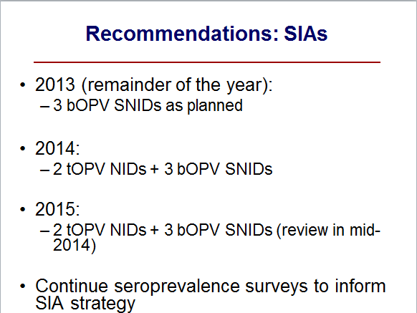
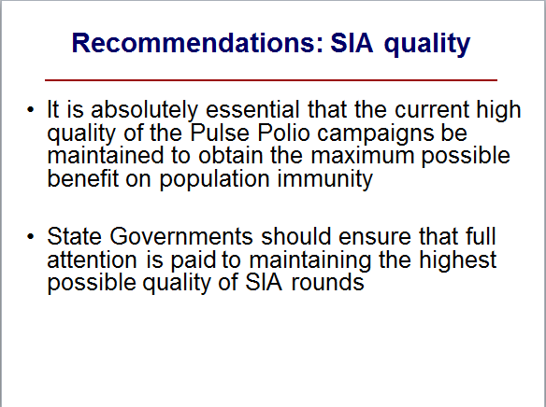
Recommendations: Maintaining immunity

Slide 4
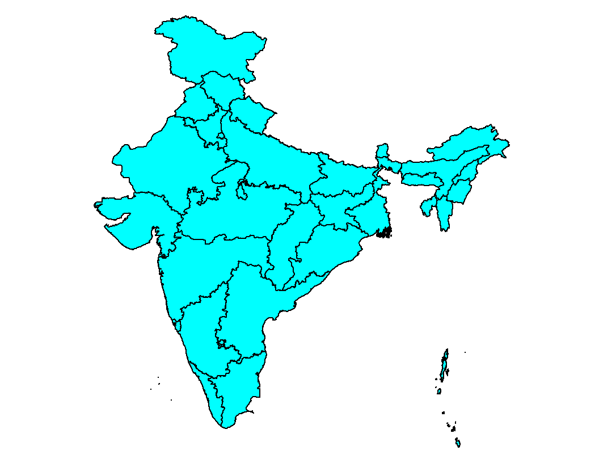
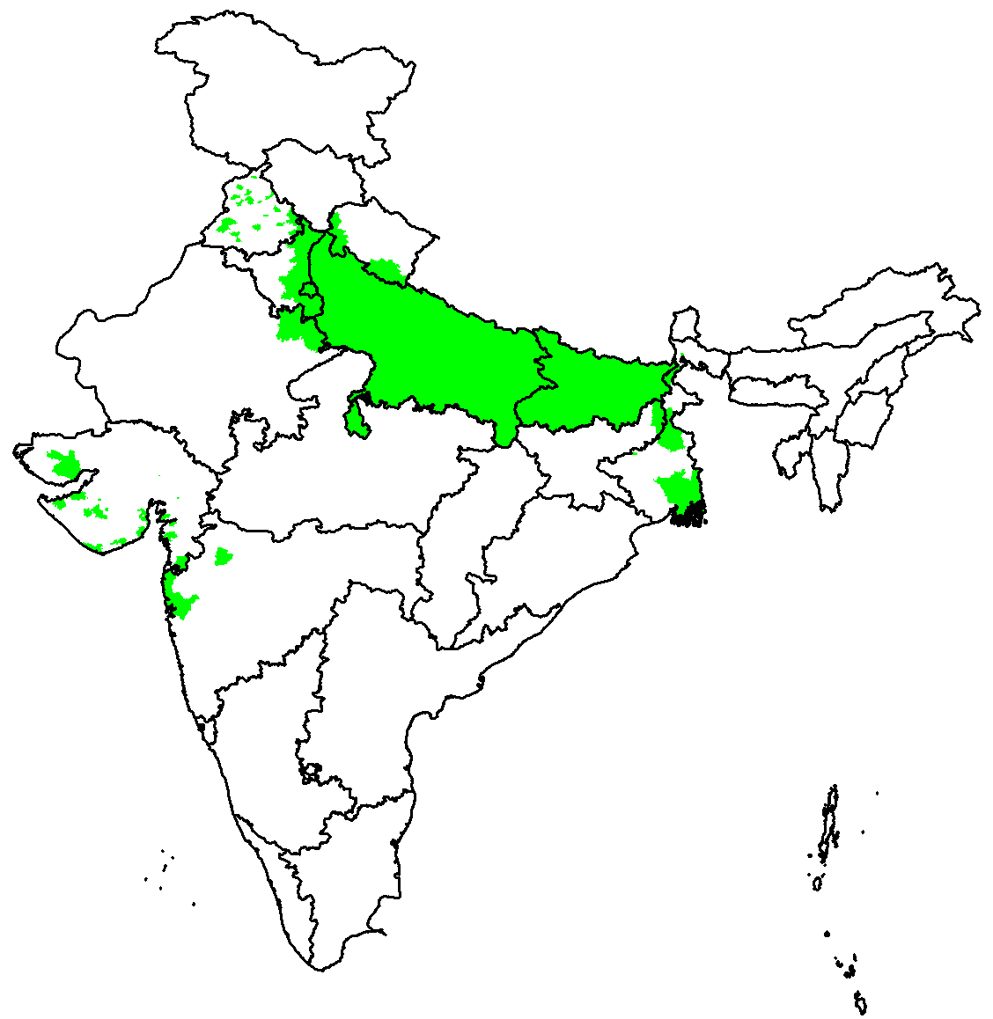
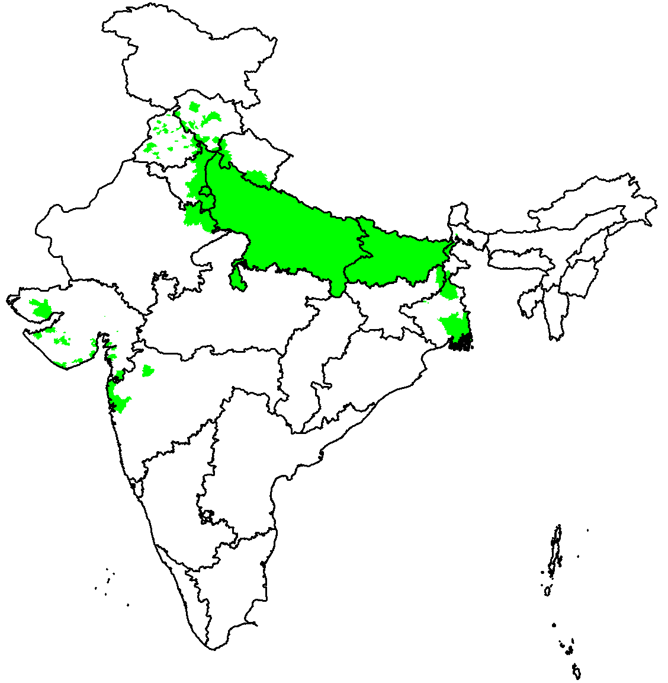
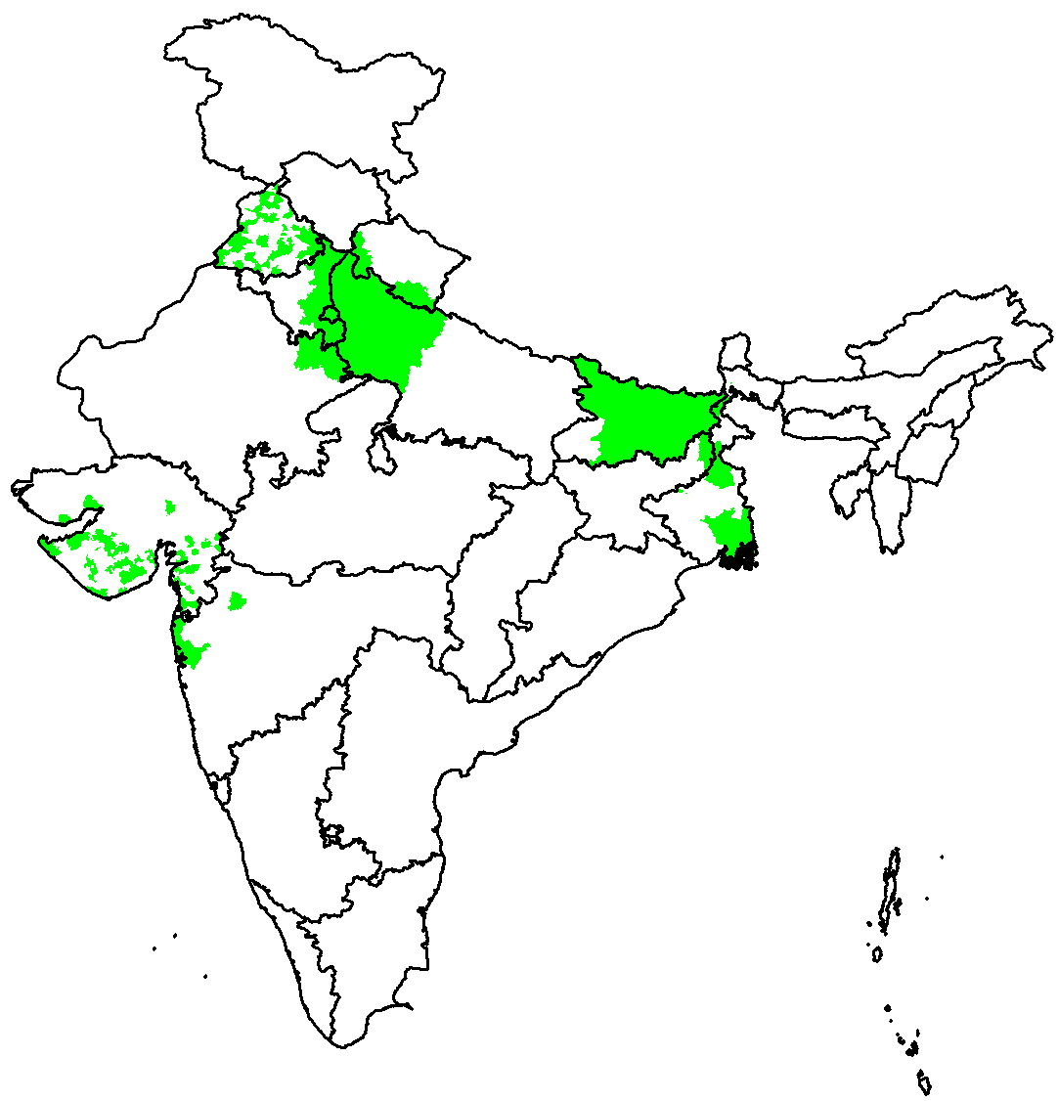
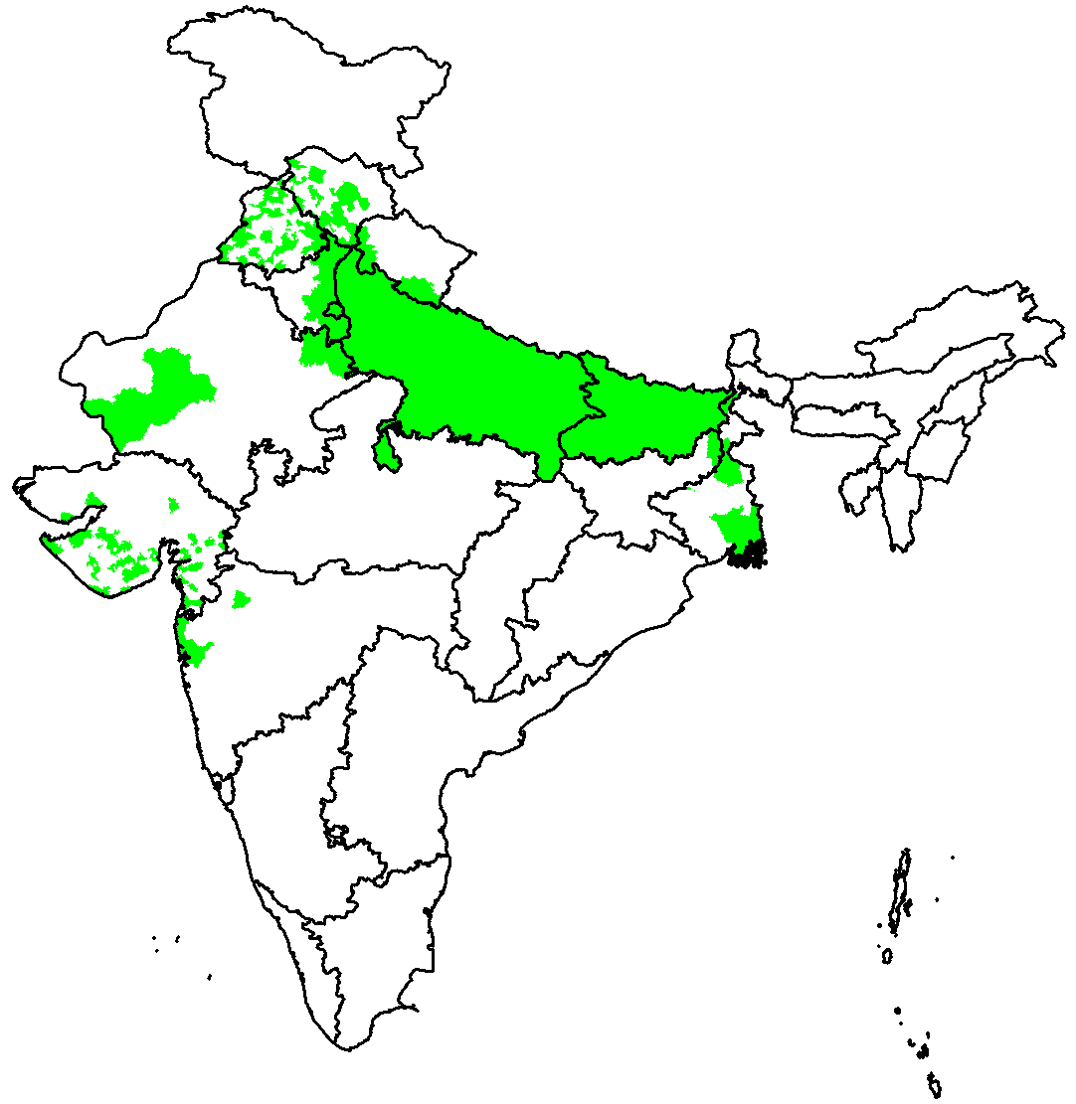
Scope and frequency of polio campaigns
2013
tOPV
bOPV
2014
2015
Conducted
Planned

Slide 5
Seroprevalence survey conducted in 2014
Sero-positivity by state, age group: 6-11 months

Slide 6
Quality of SIAs maintained
Average missed children in independent post campaign survey by state
2013
Percent unimmunized
Bihar
Uttar Pradesh
Delhi
Punjab
Jharkhand
West Bengal
Haryana
Maharashtra
Gujarat
Rajasthan
2014
Percent unimmunized
Bihar
Uttar Pradesh
Delhi
Punjab
Jharkhand
West Bengal
Haryana
Maharashtra
Gujarat
Rajasthan

Slide 7
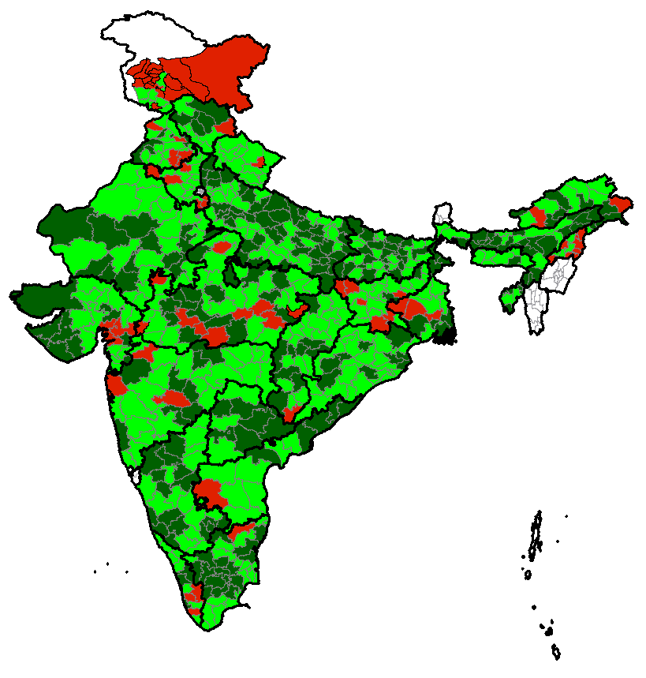
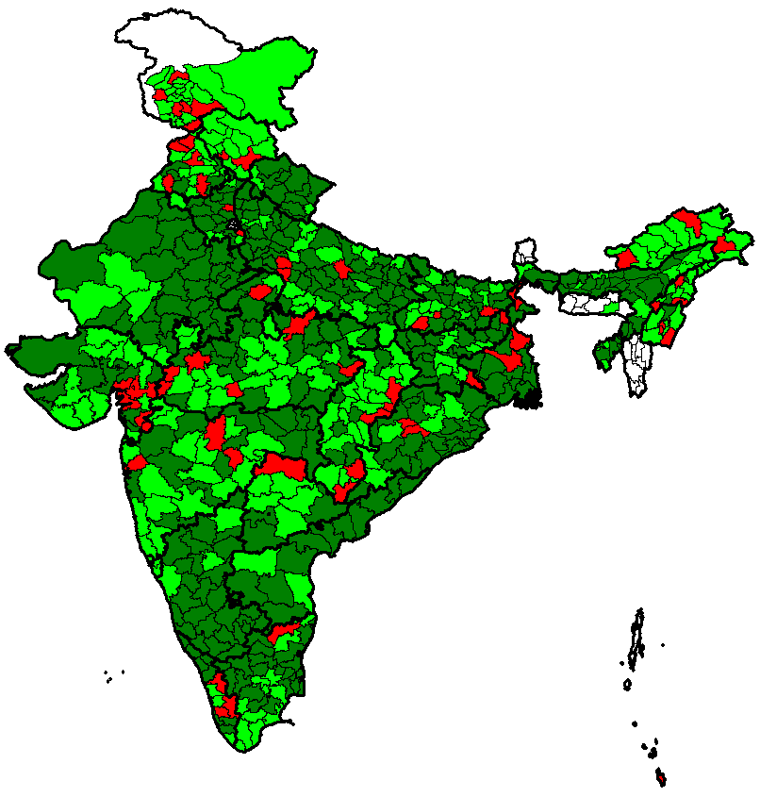
Continued involvement of government
District Task Force meetings: ranking
NIDs 2014
NIDs 2015
 | 2014 | 2015
Both DTFs good / average | 35% districts | 51% districts
One DTF good / average | 48% districts | 34% districts
Both DTFs poor | 11% districts | 10% districts
Both DTFs not held | 6% districts | 5% districts
Ranking of DTFs based on:
  Presence of DM
  Discussion time on polio
  Presence of appropriate members
  Appropriateness of decisions
  Implementation of decisions

Slide 8
25th IEAG Recommendations: Thematic areas
Maintaining immunity
Detecting and responding
Certification process
Reducing risk
Preparing tOPV/bOPV switch
Building on polio
Protecting the investments

Slide 9
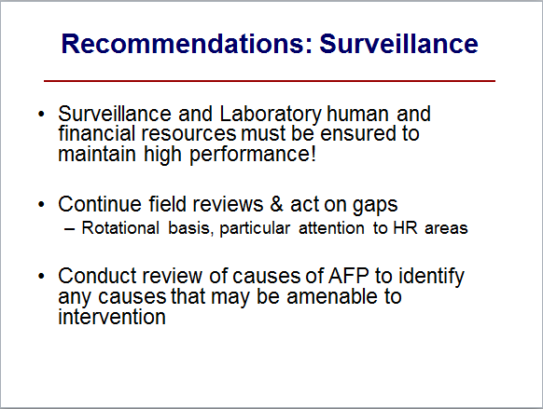
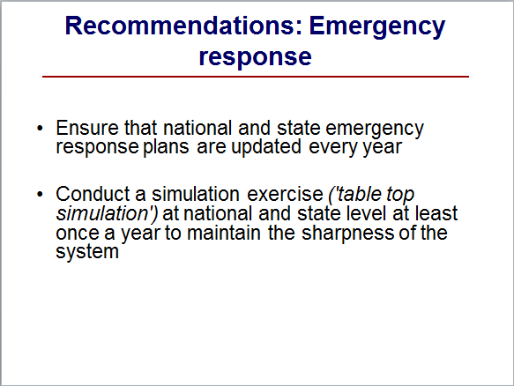
Recommendations: Detecting & responding

Slide 10
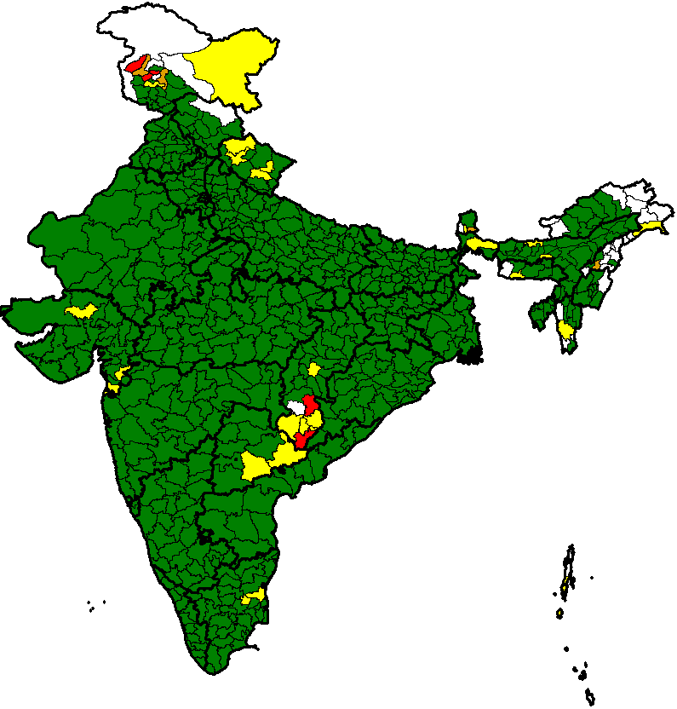
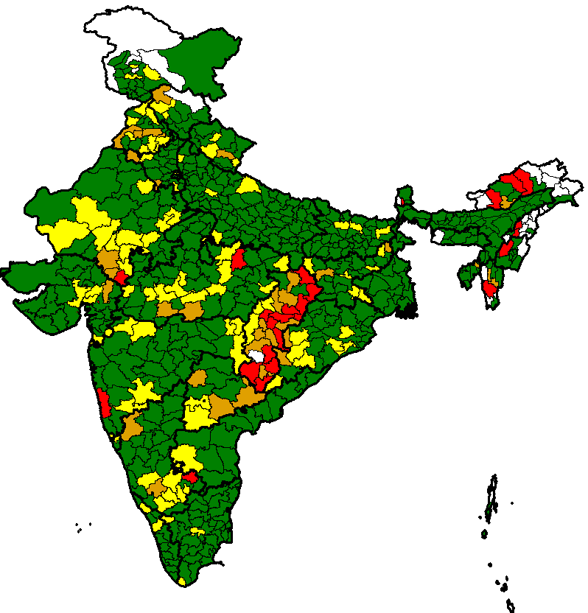
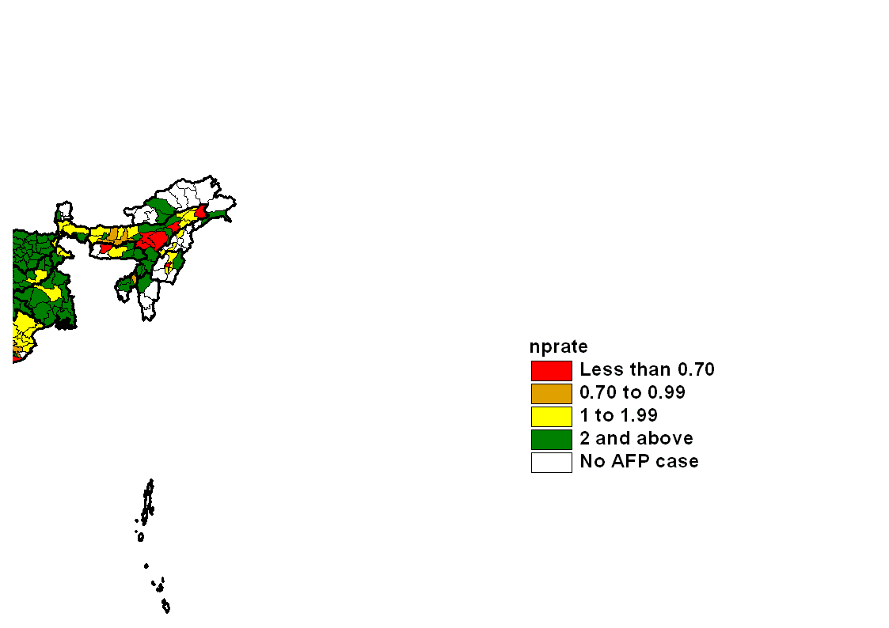
Quality of surveillance maintained at par global standards
2014*
Non-polio AFP rate
Percent AFP with adequate stool
12.08
86%
Surveillance & laboratory human resources maintained
Government funding to sustain laboratory network wef 2014
A committee of ICMR reviewing non-polio causes of AFP for identifying possibilities of public health intervention
* data as on 14 March 2015

Slide 11
Surveillance quality assurance through regular reviews
AFP surveillance cum EPI reviews
2013
2014
2015 (Planned)
Common finding: state governments need to play a greater role in field surveillance activities to sustain sensitivity as WHO transitions to other activities
Reviews modified to assess EPI in addition to surveillance

Slide 12
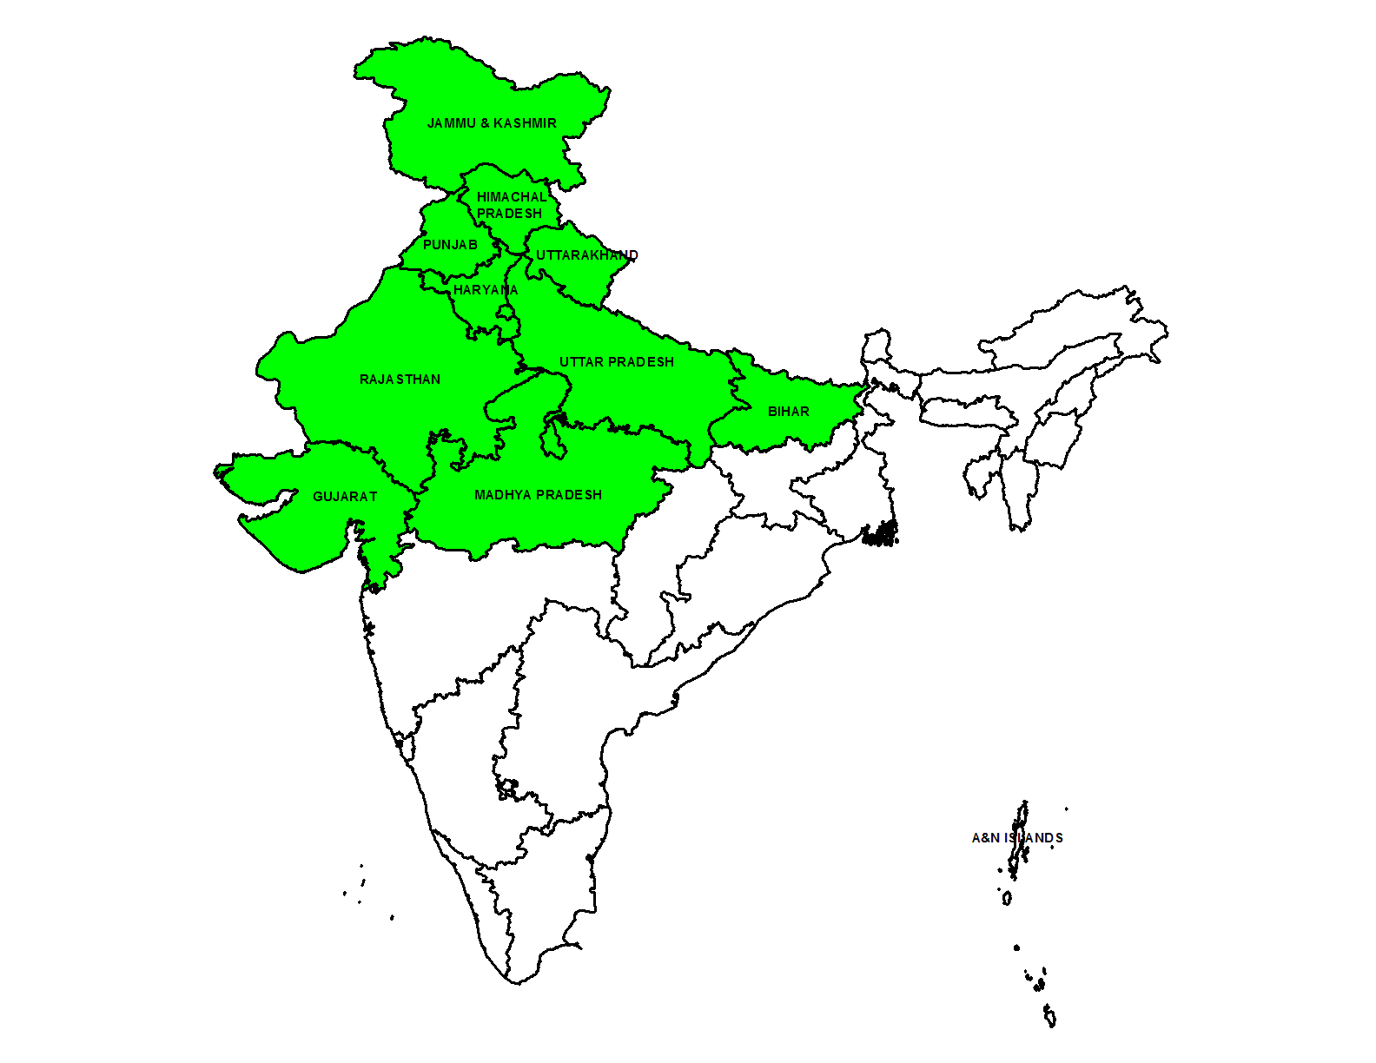
Emergency preparedness & response plan (EPRP)
Buffer stock of tOPV and bOPV maintained
Simulation exercise done in 12 states
Plans reviewed and updated
CHANDIGARH
DELHI

Slide 13
Independent observers’ score: Table-top simulation
(Consolidated for all 12 states)
Score
Max
Evaluation of Exercise
a) Capacity of the state to undertake quality mop up within 7 days
b) Ability of the state to engage media effectively
c) Capacity of the district to undertake emergency mop up within 7 days
d) Anticipation of challenges and plans to address
Min

Slide 14
25th IEAG Recommendations: Thematic areas
Maintaining immunity
Detecting and responding
Certification process
Reducing risk
Preparing tOPV/bOPV switch
Building on polio
Protecting the investments

Slide 15
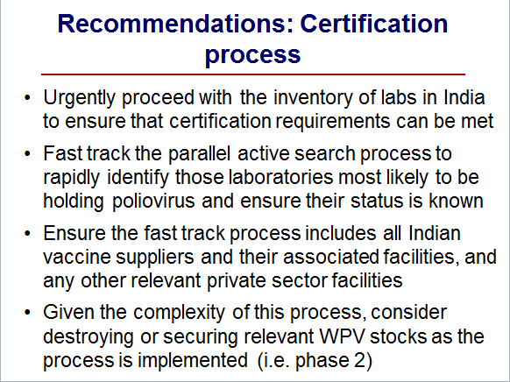

Slide 16
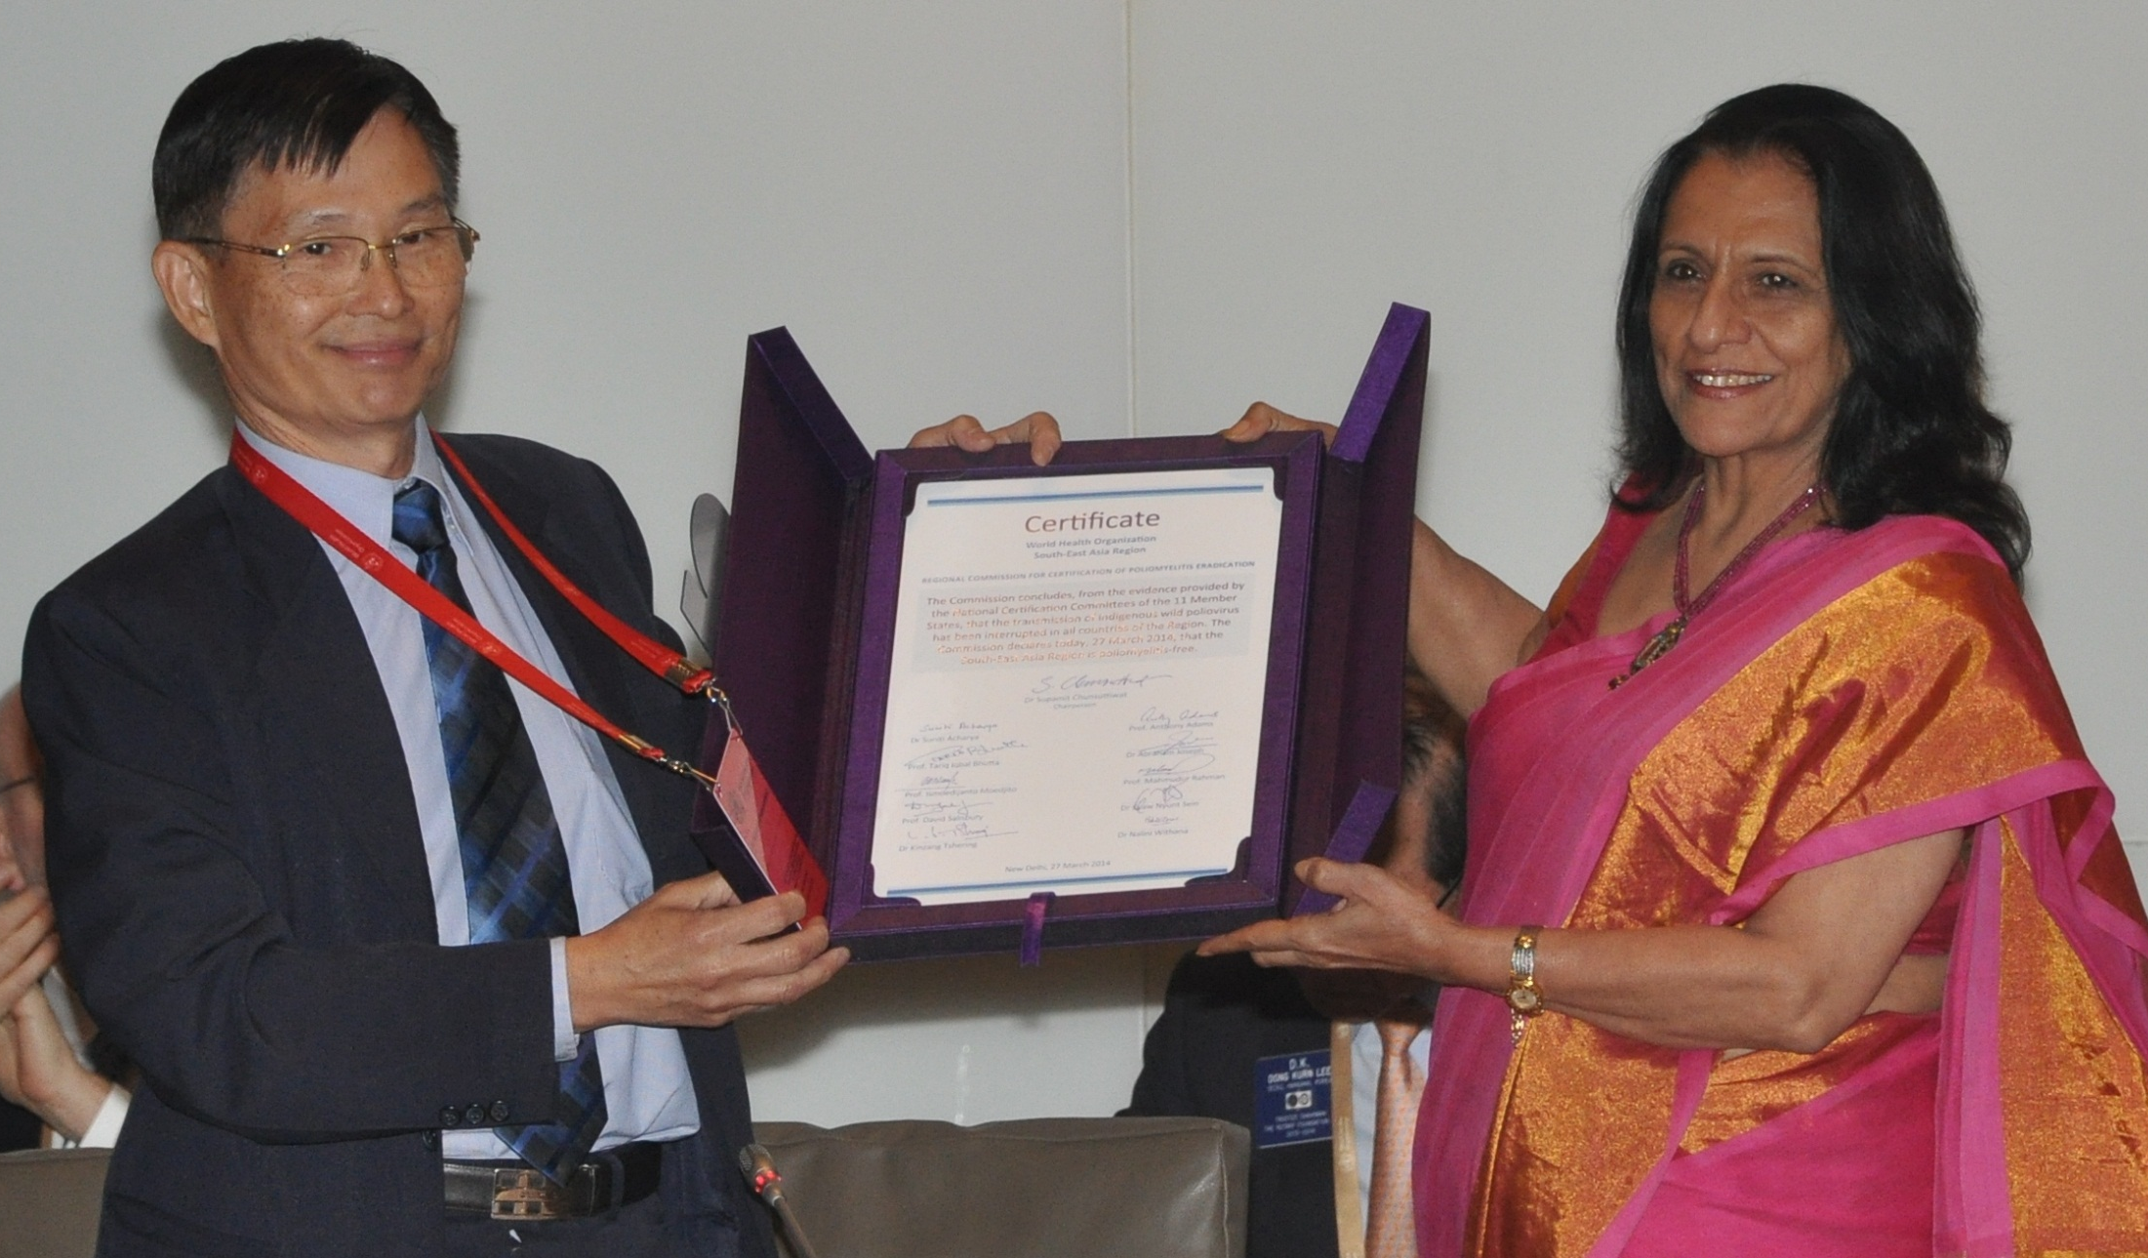
SEA region of WHO certified polio free: 27 March’14
Dr Poonam Khetrapal Singh, Regional Director, WHO SEARO receiving the polio-free certificate from the Chairperson of Regional Certification Commission for Polio Eradication

Slide 17
Mammoth task of phase 1 lab containment completed
39,644
(AFP Reporting Sites)
NPSP
+
49,547
(Active Search by Government)
+
5,903
(Web search by NTF)
National Task Force completed the inventory despite tight timelines
WHO supported for:
  drafting SOPs for searching and enlisting laboratories at district and sub district levels
  Scanning all AFP reporting sites for laboratories
  Survey of high risk laboratories
95,094
(Total Facilities Scanned)
71,469
(Laboratories surveyed)
251
(High risk labs)
High risk labs physically surveyed
51
(Laboratories have WPV infectious or potentially infectious material)

Slide 18
25th IEAG Recommendations: Thematic areas
Maintaining immunity
Detecting and responding
Certification process
Reducing risk
Preparing tOPV/bOPV switch
Building on polio
Protecting the investments

Slide 19
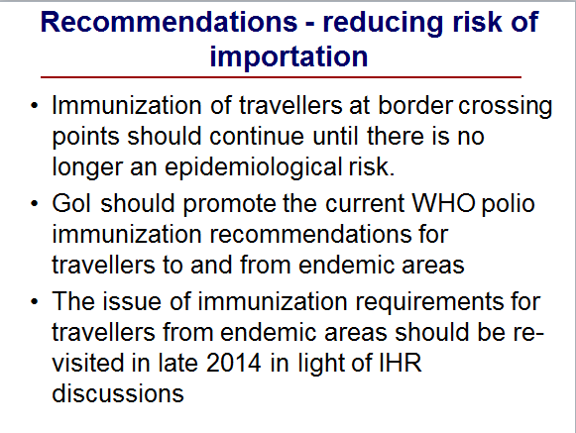
Recommendations – Reducing risk

Slide 20
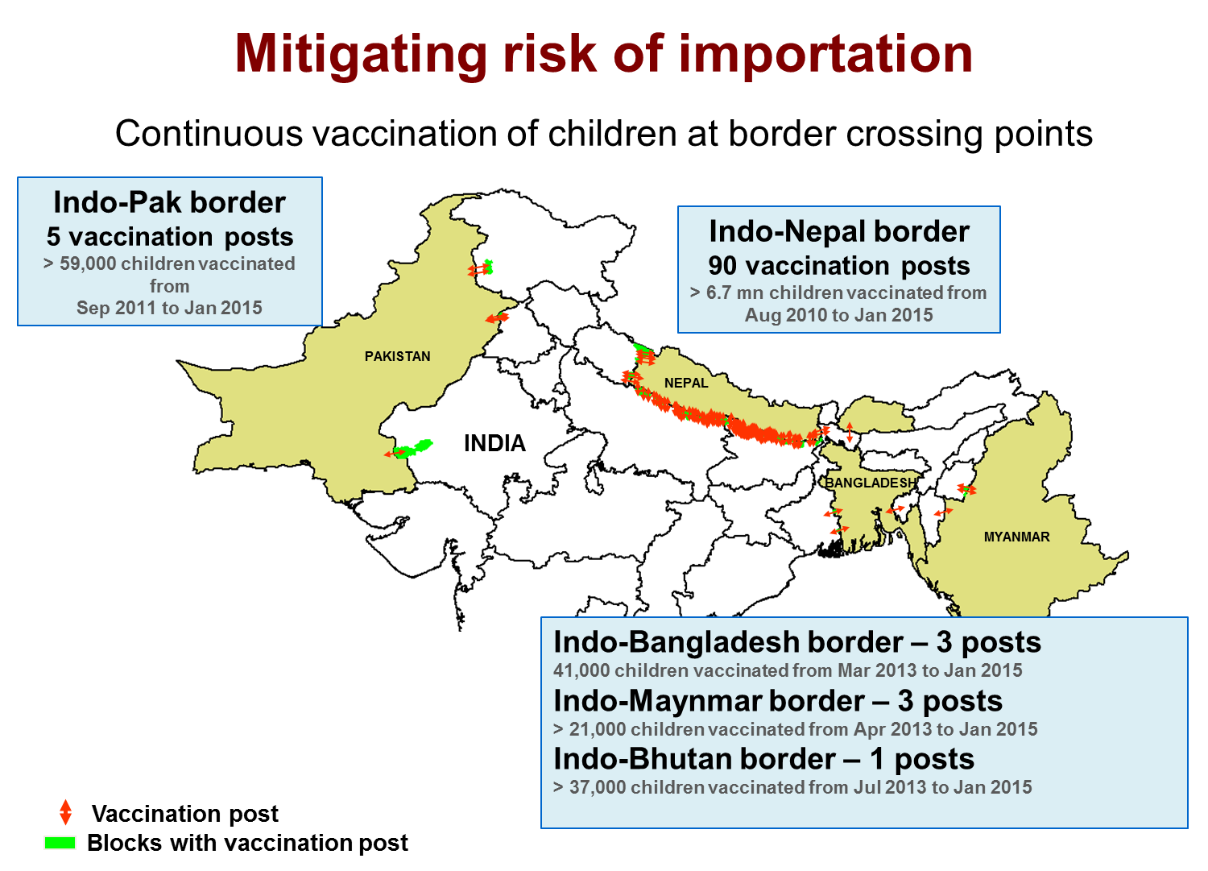
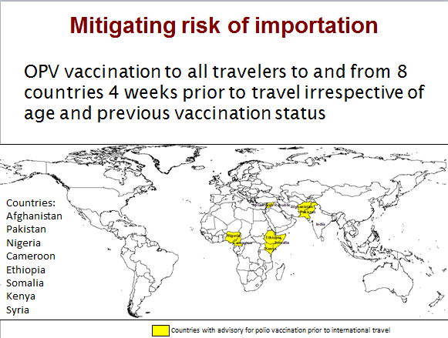
Mitigating risk of importation: Vaccination of travelers
Vaccination at borders
Vaccination of travelers to/from infected countries

Slide 21
25th IEAG Recommendations: Thematic areas
Maintaining immunity
Detecting and responding
Certification process
Reducing risk
Preparing tOPV/bOPV switch
Building on polio
Protecting the investments

Slide 22
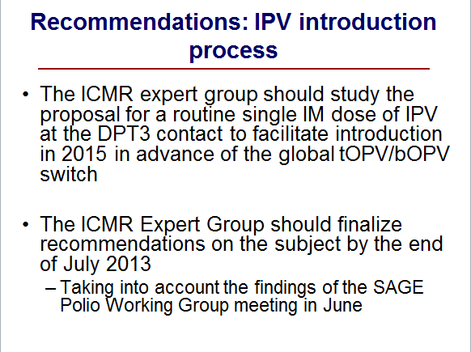
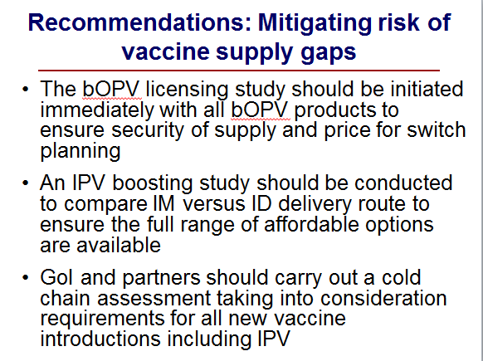
Recommendations: Preparing tOPV/bOPV switch

Slide 23
Progress on tOPV/bOPV switch
Study completed to assess the efficacy of bOPV and IPV at DPT3 in routine immunization
Study report on bOPV use in RI submitted to DCGI for licensure
Policy decision taken in June 2014 by NTAGI to introduce single dose of IPV in RI
GAVI supporting first year IPV procurement and supply
IPV single & 10 dose vials licensed, 5 dose vial licensure under process
Cold chain assessment for IPV introduction done

Slide 24
Cold chain assessment

Slide 25
Number of vaccine stores in India
Cold Chain Points
Store level | Numbers
GMSD | 4
State Vaccine stores | 53
Regional Vaccine stores | 109
District Vaccine stores | 666
CHC* | 2161
PHC* | 16551
Others | 6844
Total# | 26384

Slide 26
Cold Chain inventory
Total No. of Cold Chain Points | 26,384
National cold chain MIS (NCCMIS) data updated | 674 districts
ILR | 33447
DF | 31354
ILR indented | 13205
DF indented | 11640
No. of Cold Chain technicians | 456
Technicians trained on WIC/WIF (2014-15) till date | 140
Technicians trained on ILR/DF (2014-15) till date | 98

Slide 27
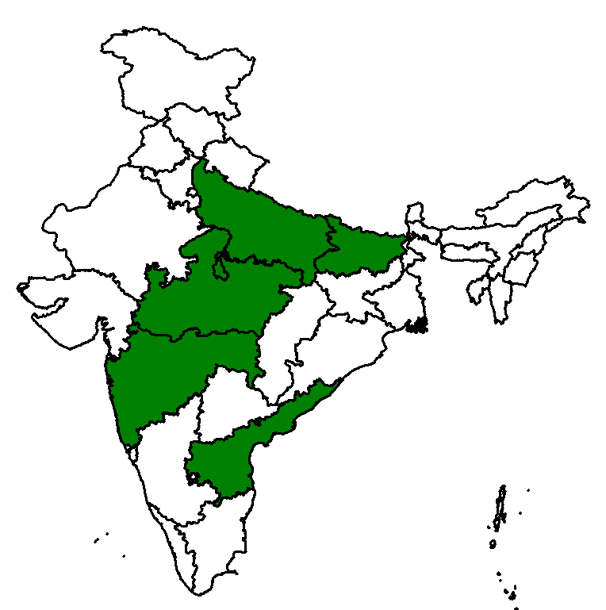
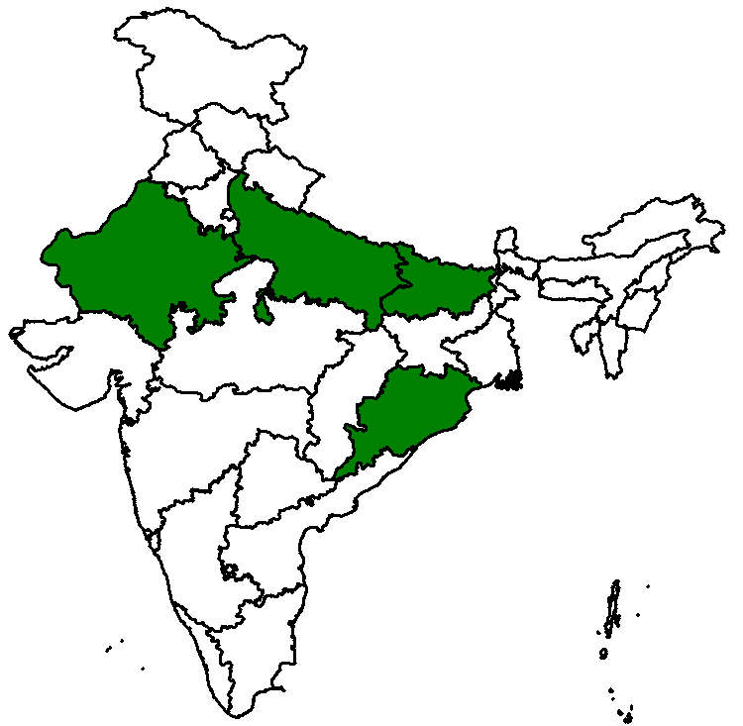
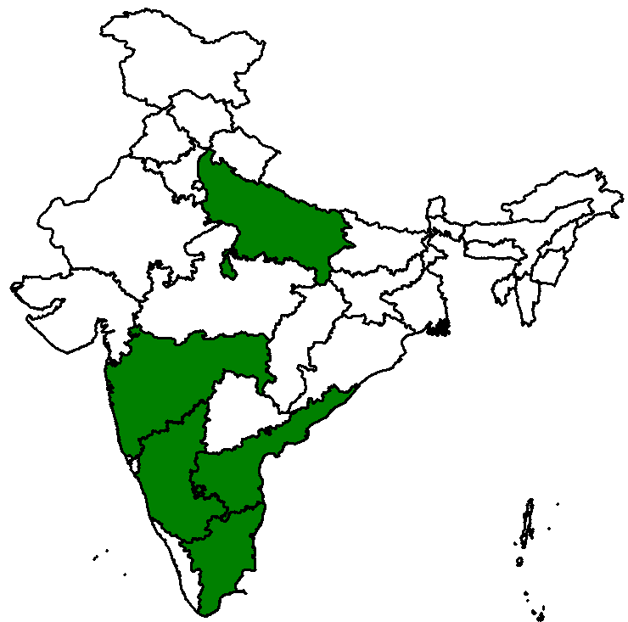
Additional requirement -IPV - NCCA-2014
State level
5 states
District level
4 states
Sub-district level
5 states
48 WICs needed
2,601 ILRs needed
11,641 ILRs needed

Slide 28
Strengthening the cold chain logistics
National Cold chain assessment (NCCA) was carried out in 2014-15 focussing on gaps in cold chain considering introduction of newer vaccines and for phasing out CFC equipment as well.
Development of National Cold Chain and Vaccine Logistics Action Plan (NCCVLAP)-Under GAVI HSS support focusing on findings of National Effective Vaccine Management (EVM) assessment.
NCCTC and NCCVMRC have trained 238 technicians on ILR/DF and WIC/WIF repair and maintenance.
Solar inverters and hybrid solar invertors or SDD are encouraged for the areas with deficient electricity supply through NHM funding.
483 number of vaccine vans are supplied to strengthen distribution of vaccine to CCP and 151 number will be supplied by June 2015.

Slide 29
Strengthening the cold chain logistics Contd
Additional support of 1200 ILR(L), 1200 ILR(S) and 1200 DF (L) along with 250 Solar Direct Drive from UNICEF to strengthen cold chain.
Effective Cold Chain and Vaccine Management Course (ECCVMC) has been designed for SIOs, CCOs and VLMs.
Bulk cold chain Capacity building of States: 10 nos. of 40 cubic mtr WIC and 2 nos of WIF recently supplied to Bihar, UP, Rajasthan and GMSD Karnal under GAVI support. Installation will be carried out in next three months.
GMSDs cold chain capacity building with support of M/S HLL. 200 cubic mtrs of WIC will be supplied to GMSD Kolkata and Mumbai, 100 cubic Mtr to Chennai, 60 cubic mtr to Hyderabad and 40 cubic mtr to Guwahati.
States encouraged for decentralized procurement as per the need under DGS&D rate contract.

Slide 30
25th IEAG Recommendations: Thematic areas
Maintaining immunity
Detecting and responding
Certification process
Reducing risk
Preparing tOPV/bOPV switch
Building on polio
Protecting the investments

Slide 31
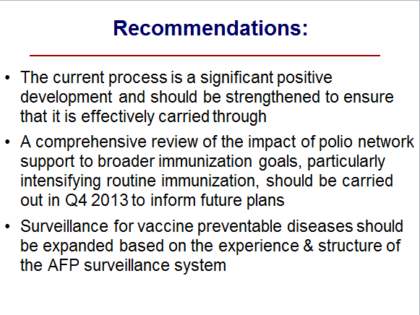
Recommendations: Building on polio

Slide 32
Building on polio
Polio infrastructure of WHO-NPSP being used for broader health gains
  Strengthening routine immunization
  AEFI surveillance
  Measles elimination & rubella and CRS control
  Kala-azar elimination
  Maternal & neonatal tetanus elimination
  Establishing laboratory supported vaccine preventable disease (VPD) surveillance based on the AFP surveillance system

Slide 33
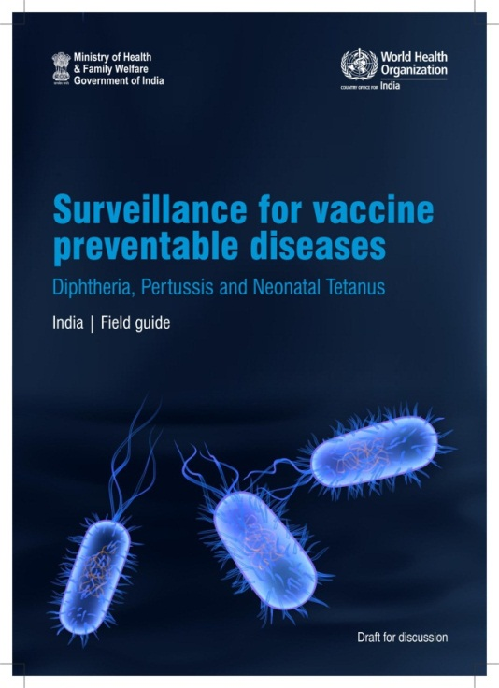
VPD surveillance
Surveillance for diphtheria, pertussis and neonatal tetanus launched in Haryana with support from WHO-India
Polio surveillance used as a platform
Laboratory confirmation of suspected cases of diphtheria and pertussis an integral part of surveillance
Plan to expand VPD surveillance in three additional states in 2015

Slide 34
25th IEAG Recommendations: Thematic areas
Maintaining immunity
Detecting and responding
Certification process
Reducing risk
Preparing tOPV/bOPV switch
Building on polio
Protecting the investments

Slide 35
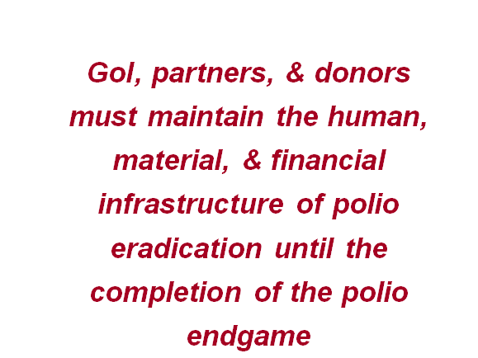
Recommendations: Protecting the investments

Slide 36
Protecting the investments
Polio eradication remains a priority for government & partners
Sustained financial commitment from GoI for polio eradication activities
Partners have maintained polio human resources & infrastructure
  Partners transitioning to support routine immunization strengthening & other health interventions for broader public health gains
Polio laboratory operations funding provided by GoI since January 2014

Slide 37
Thanks

