Slide 1

Dr. Rakesh Kumar
Joint Secretary (RCH)
Ministry of Health and Family Welfare,
Government of India
Polio Eradication in India
(Status, Risks & Priorities)
India Expert Advisory Group Meeting

Slide 2
Presentation outline
Current status of polio eradication
  Polio free since January 2011
Risks
Programme priorities

Slide 3
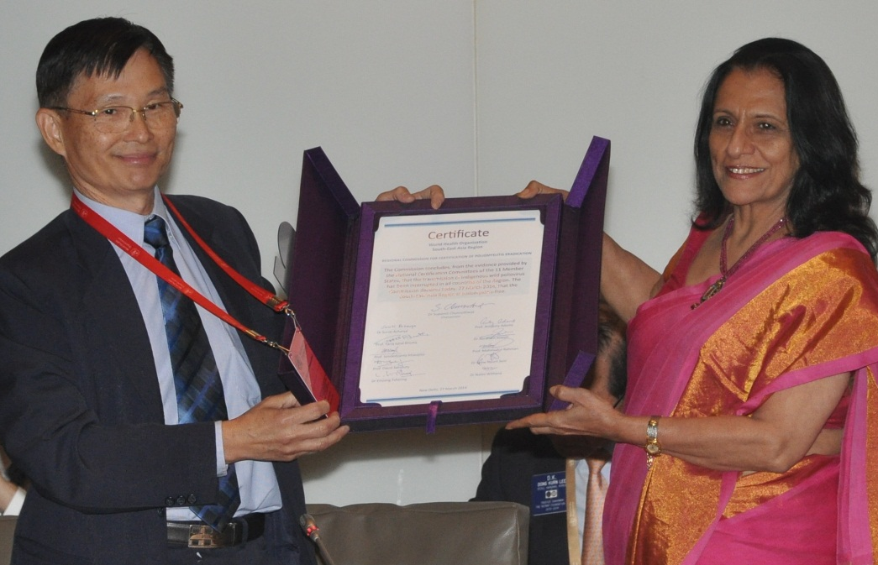
27 March 2014
WHO South-East Asia Region certified polio-free
Dr Poonam Khetrapal Singh, Regional Director, WHO SEARO receiving the polio-free certificate from the Chairperson of Regional Certification Commission for Polio Eradication

Slide 4
Polio free status maintained for >4 years
1934
1600
Yr1
Yr2
Yr3
Yr4
P1 wild
P2 wild
P3 wild
* data as on 14 March 2015

Slide 5
Environmental surveillance confirms no WPV since January 2011 in the country
Wild poliovirus type 1
Negative for wild poliovirus
Scheduled but sample not collected
X
Wild poliovirus type 3
Result pending
Sampling not scheduled

Slide 6
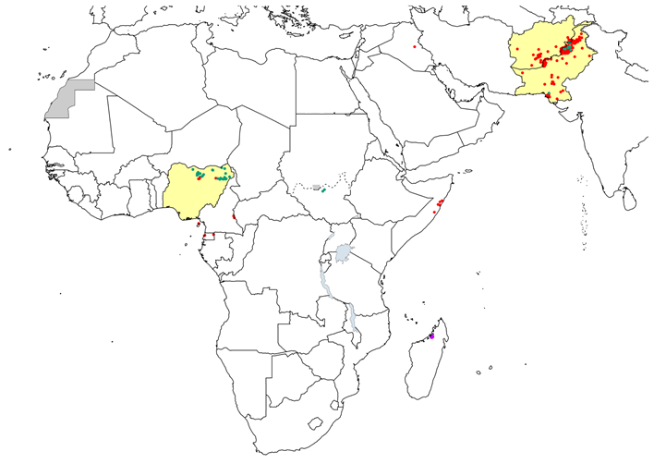
But the Risk remains…
International importation of wild poliovirus
Active WPV transmission in 2014* 359 cases reported in the year
Pakistan | 306
Afghanistan | 28
Nigeria | 6
Cameroon | 5
Equatorial Guinea | 5
Somalia | 5
Iraq | 2
Syria | 1
Ethiopia | 1
Wild poliovirus type 1
cVDPV type 2
cVDPV type 1
Endemic country
Onset of paralysis 11 March 2014 – 10 March 2015

Slide 7
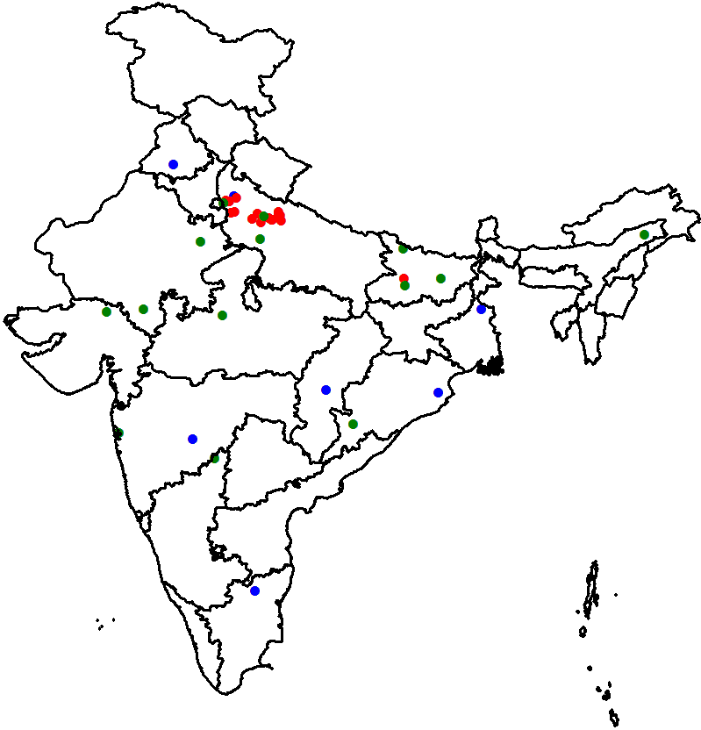
VDPVs detected in India, 2009-2015*
2009-2015
aVDPV
cVDPV
iVDPV
Year | A-VDPV | C-VDPV | I-VDPV | Total
2009 | 3 | 17 | 1 | 21
2010 | 1 | 3 | 1 | 5
2011 | 4 |  | 3 | 7
2012 |  |  | 1 | 1
2013 | 3 |  | 2 | 5
2014 | 3 |  |  | 3
2015* |  |  |  | 0
Total | 14 | 20 | 8 | 42
Year | P1-VDPV | P2-VDPV | P3-VDPV | Total
2009 | 2 | 19 |  | 21
2010 |  | 5 |  | 5
2011 |  | 6 | 1 | 7
2012 |  | 1 |  | 1
2013 |  | 5 |  | 5
2014 |  | 3 |  | 3
2015* |  |  |  | 0
Total | 2 | 39 | 1 | 42
* data as on 14 March 2015

Slide 8
Maintaining quality of SIAs

Slide 9
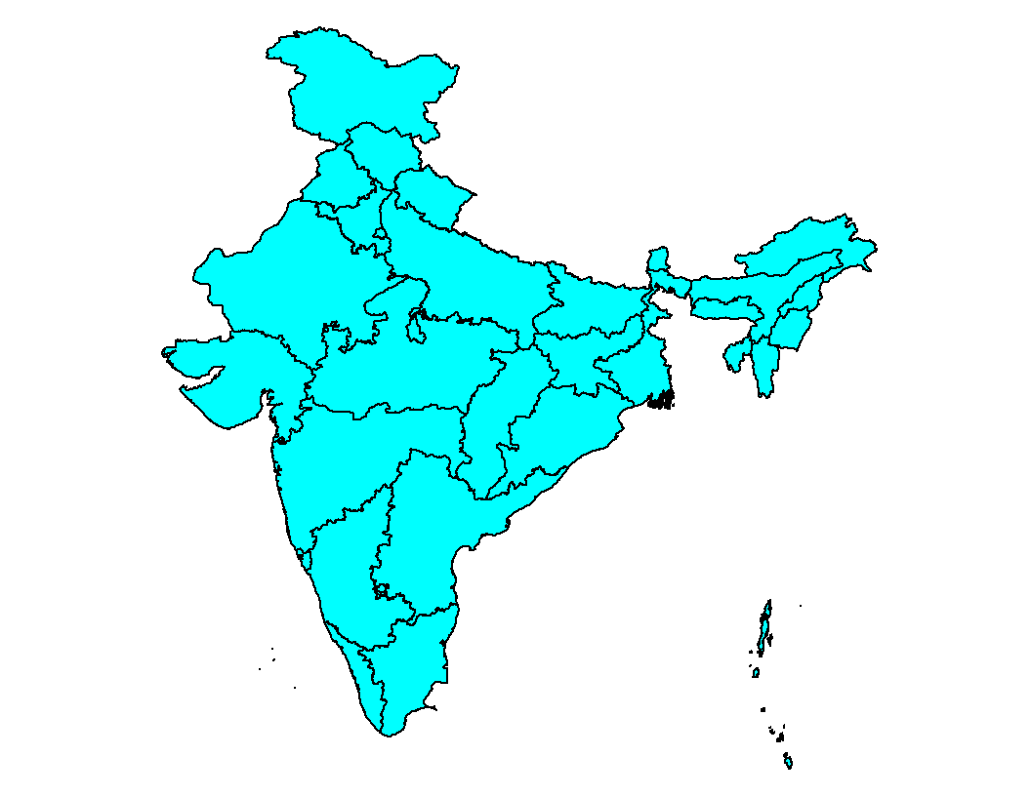
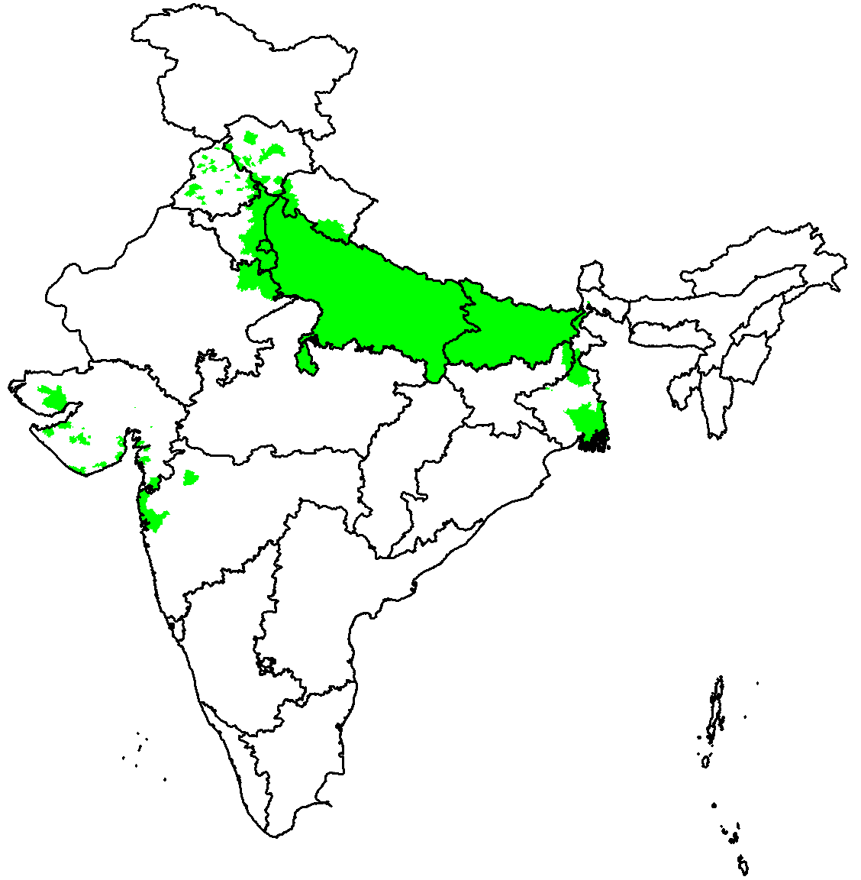
Scope and frequency of polio campaigns
National Immunization Day
Coverage ~ 170 mn with tOPV
Sub-national Immunization Day
Coverage ~ 75 mn with bOPV
=
=
2013
2014
2015
Conducted
Planned

Slide 10
High coverage in highest risk areas
Missed children in independent post campaign survey
Percentage unimmunized
2010
2011
2012
2013
2014
2015
Number of children checked during each campaign:
UP: ~ 60,000 children
Bihar: ~ 150,000 children
Source of data : NPSP monitoring

Slide 11
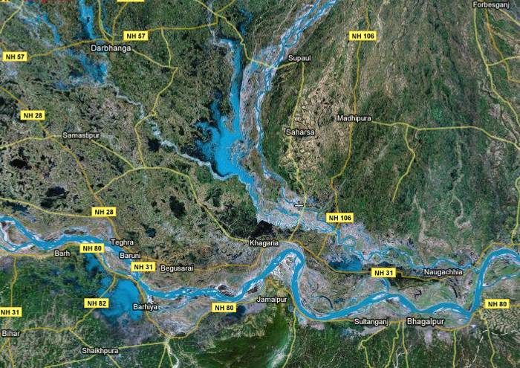
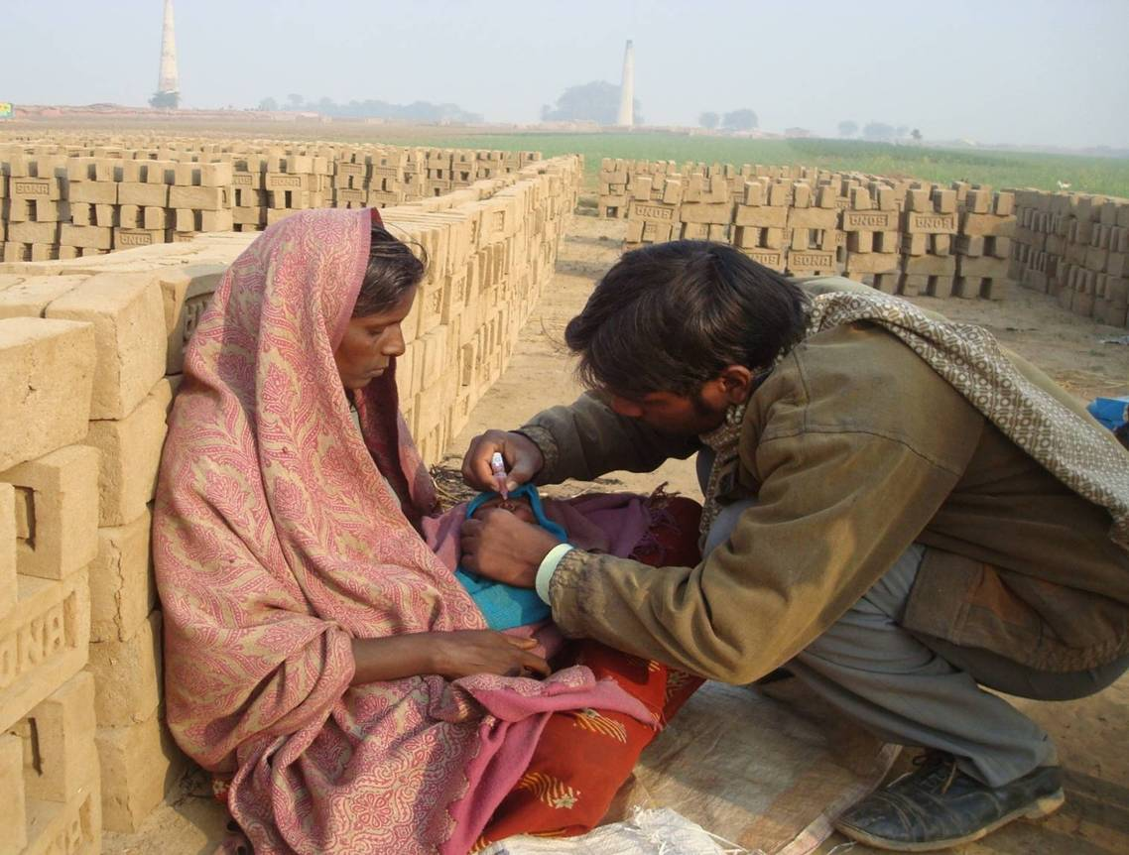
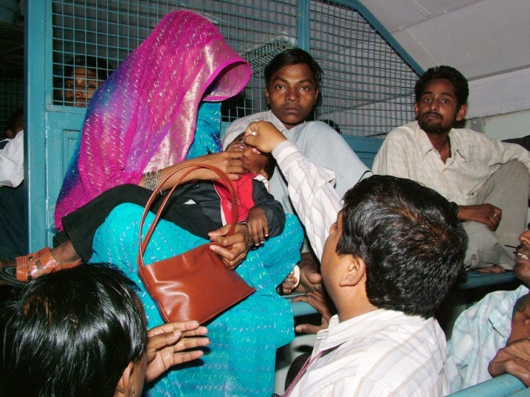
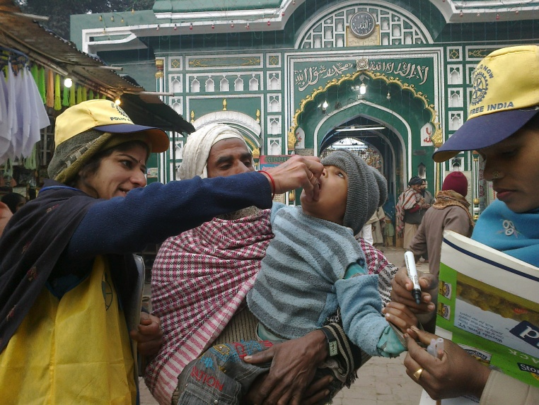
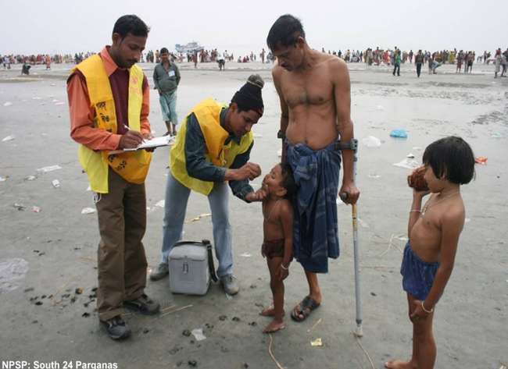
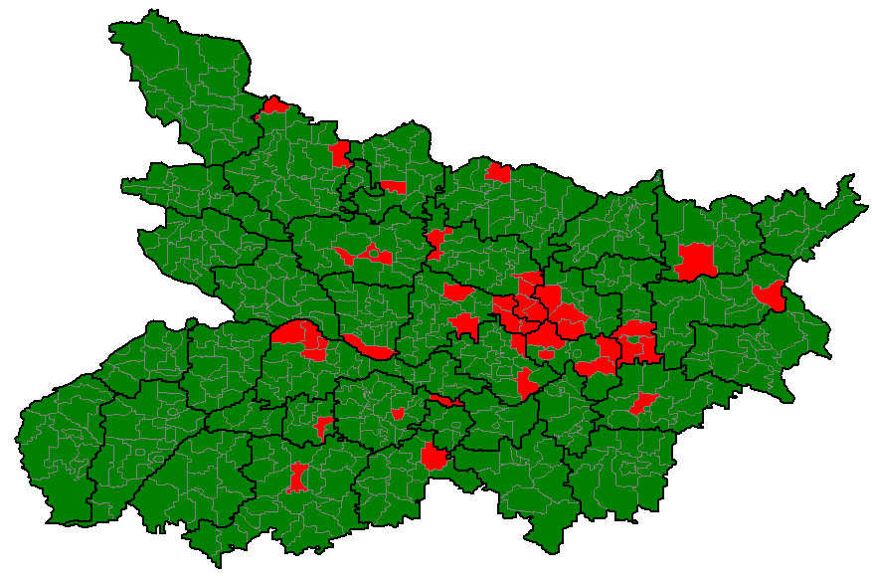
Past innovations & learnings being continued
Kosi operational plan
Migrant and mobile strategy
Underserved strategy
Vaccination during congregations
107 HR block plan
West UP:
HR blocks – 66
Bihar:
HR blocks – 41

Slide 12
Social mobilization
Record low levels of resistance: less than 0.5% in both UP & Bihar
XR house Uttar Pradesh
Continued high coverage over 99% in high risk areas of UP & Bihar
7300+ strong mobilizers under UNICEF social mobilization Network in 3 states
Over 50,000 community influencers and ‘informers’ engaged in support
High visibility maintained (over 95% in high risk areas of SMNet)
Reach over 3 million house-holds having about 2.2 million children under five years
Increasing demand – high booth coverage in high risk areas where CMCs deployed
0.3% in Feb 2015
0.05% in Feb 2015
Source:SMNet

Slide 13
Strengthening
Routine Immunization

Slide 14
Full immunization coverage
Overall increase in full immunization coverage (FIC)
FIC increased from 14 million children to 15 million, coverage increase of 1 million children since 2009
* - Children are fully immunized when they have received vaccination against TB, 3 doses of DPT & Polio & a dose of Measles
Notes:
Overall increase in full immunization coverage
Full Immunization increased from 14 million children to 15 million, increase coverage of 1 million children since 2009;
Drop out From DPT2 to 3: around 10 %; OPV2 to 3: 9 points

Slide 15
Estimated missed children
(RSOC 2013-14)
Drop-out
Left-out
<100,000
100,000 to 300,000
300,000 to 500,000
500,000 to 700,000
~7.2 million
>=700,000
~1.7 million
* Estimation based HMIS target Live Births (14-15) & RSOC coverage

Slide 16
Why are the children missed?
No immunization
Partial
Immunization
Full
immunization
Number of children monitored = 257,344
N = 81,218
* Data from January 2014 to October 2014
Source : RI house to house monitoring data

Slide 17
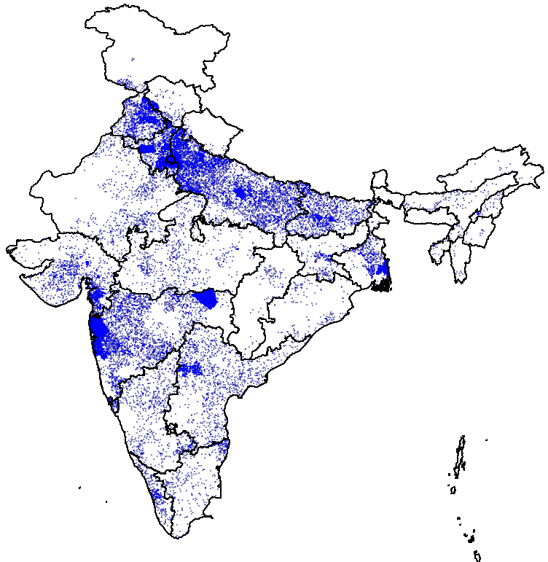
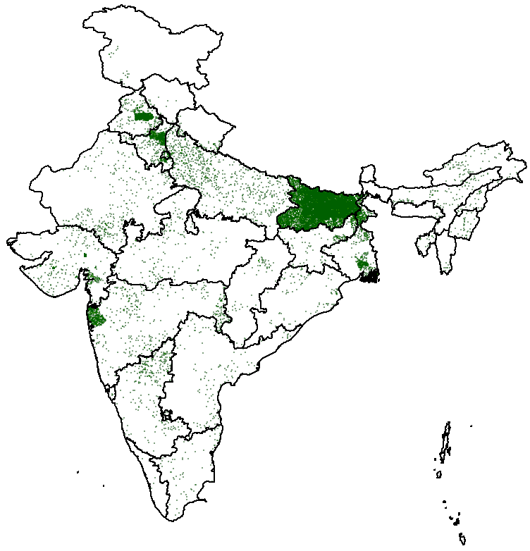
Improved RI Microplans
Inclusion of 400,000 high risk settlements in RI microplans
~ 166,000 HR areas in settled population
~ 256,000 Migrant sites
= 10 Migrant sites
= 10 High-risk sites

Slide 18
Percent HRAs included in RI microplans
Percent HRAs included in RI microplans
9 priority states
97%
2012
2013
2014
2015
<80%
80% to 85%
85% to 90%
>= 90%
~ 400,000 HRAs identified and targeted for linking to session sites
*data as on 16 Mar 2015

Slide 19
Capacity building of frontline workers on RI
(9 priority states)
Of 1.3 million frontline workers, nearly 1.1 million trained
Health workers
ASHA
Anganwadi Workers
89%
86%
82%
N = 152,496
N = 520,071
N = 639,375
< 60%
60% to 70%
70% to 80%
80% to 90%
Data Source : WHO-NPSP IRI progress data as on 16 Mar 2014
> = 90%
N=Training load in the category

Slide 20
Establishing accountability framework
(State & district task forces for immunization activated)
36 states
668 districts
Not constituted (3 states)
Not constituted (9 districts)
No meeting held (7 states)
No meeting held (74 districts)
1 STFI meeting held ( 14 states)
1 DTFI meeting held (164 districts)
2-3 STFI meetings held (6 states)
2-3 DTFI meetings held (136 districts)
>=4 STFI meetings held (6 states)
>=4 DTFI meetings held (285 districts)
* Data as on 20 Jan 15

Slide 21
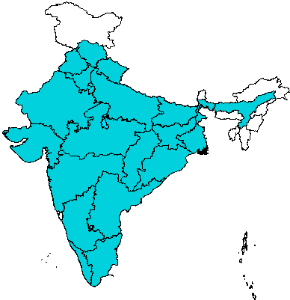
Intensive RI monitoring data used to drive DTFI
24 States
Focus states
State | Sessions monitored | Children monitored
Uttar Pradesh | 92,000 | 640,000
Bihar | 52,000 | 327,000
Madhya Pradesh | 580 | 2,200
Rajasthan | 970 | 3,900
Total: India
Sessions monitored: 167,000
Children monitored: 1,158,000

Slide 22

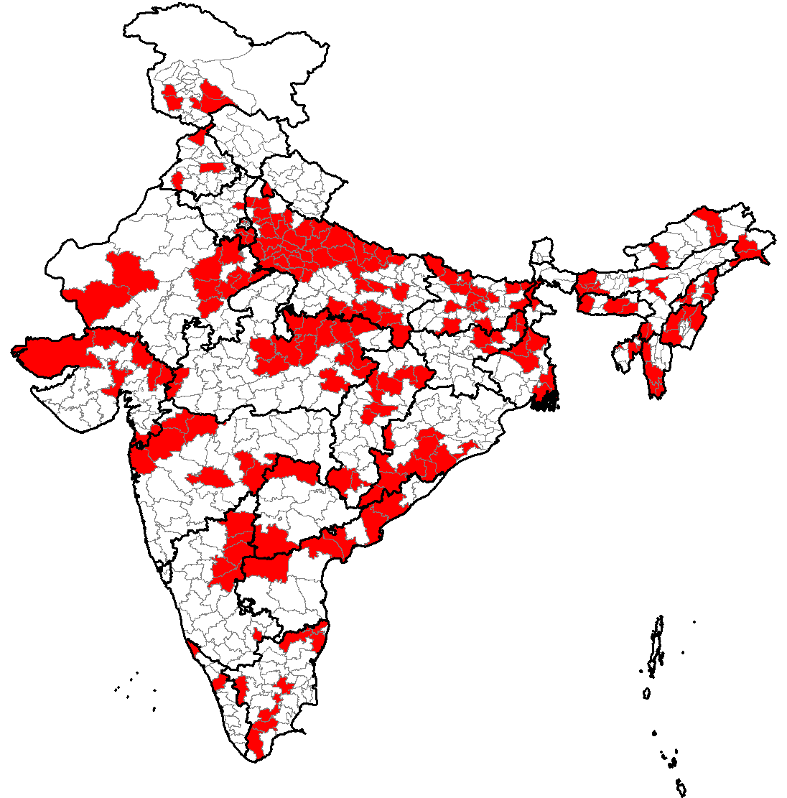
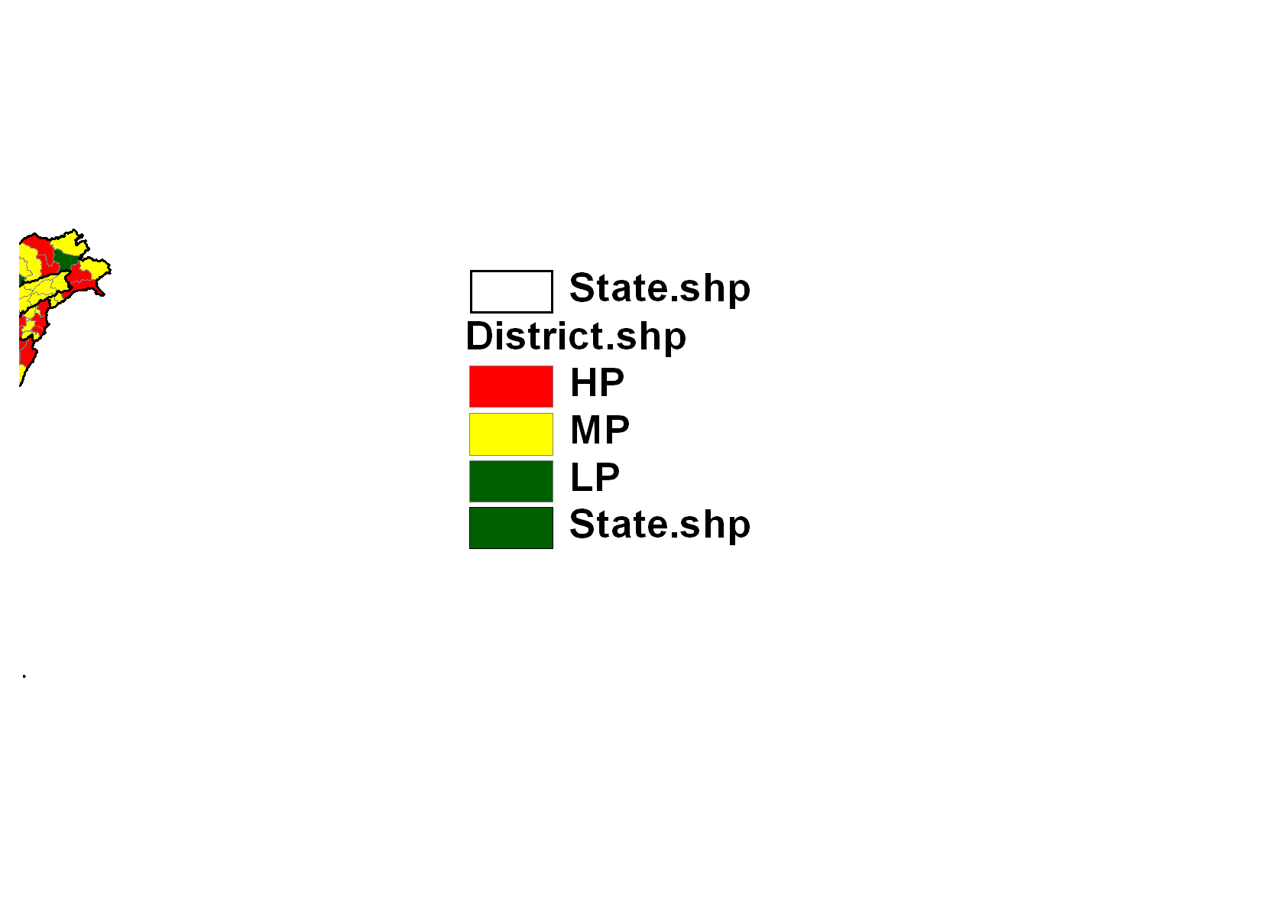
Mission Indradhanush launched
(Catching up missed children)
Focus on 201 high focus districts with largest number of partially vaccinated & left-out children
Intensified efforts on social mobilization, microplanning, training and monitoring
Regular performance review at all levels
Active engagement of State Governments & partner agencies – WHO, UNICEF & Rotary
High Focus districts

Slide 23
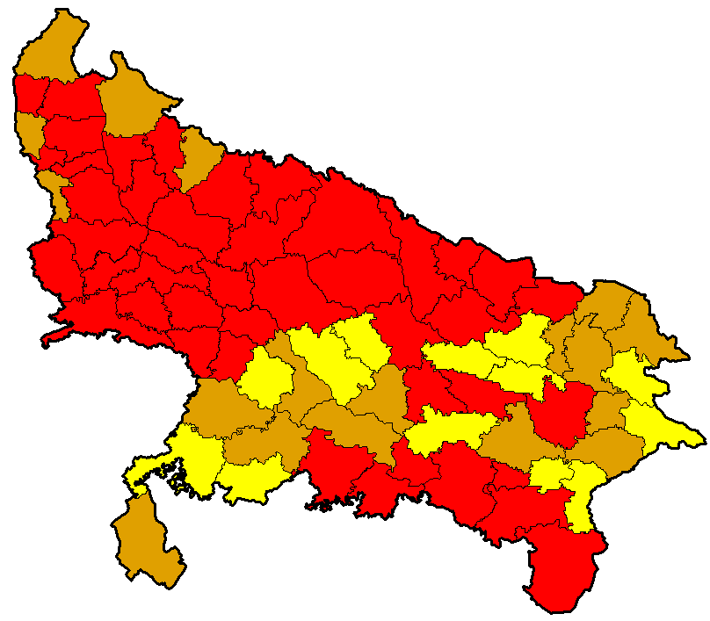
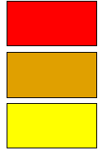
District prioritization for Indradhanush in UP
(Based on AHS 2012 – 13)
High priority (7 to 10 points) – 44 districts
Medium priority (5 to 6 points) – 18 districts
Low priority (<=4 points) – 13 districts
Scoring criteria:
<50% Full immunization or >40,000 missed children – 7 points
50% to 60% Full immunization or 30,000 to 40,000 missed children – 5 points
>=60% Full immunization – 3 points
High risk district as per EPRP – 2 points
High Priority district – 1 point

Slide 24

Strategy for Mission Indradhanush
Number of rounds: four rounds will be conducted in 2015 beginning on 7 April, 2015.
Duration of each round: upto seven days (based on need)
Targeted beneficiaries: Children under two years of age and pregnant women focusing on HRAs
  Children above two years of age seeking vaccination at any Indradhanush session will not be denied due vaccines
Mechanism
  Fixed or outreach sessions
  Mobile sessions
Engagement of Partners on the lines of Polio

Slide 25
Key steps for Mission Indradhanush
Meticulous planning of vaccination sessions through revision of micro plans in all blocks and urban areas
Effective communication and social mobilization to generate demand for immunization services through mass media, mid media, interpersonal communication (IPC), school and youth networks and corporates
Intensive training of the health officials and frontline workers
Establish accountability framework through state and district task forces for immunization
Use of concurrent monitoring data to plug the gaps in implementation

Slide 26
Maintaining vigil:
AFP & environmental surveillance

Slide 27
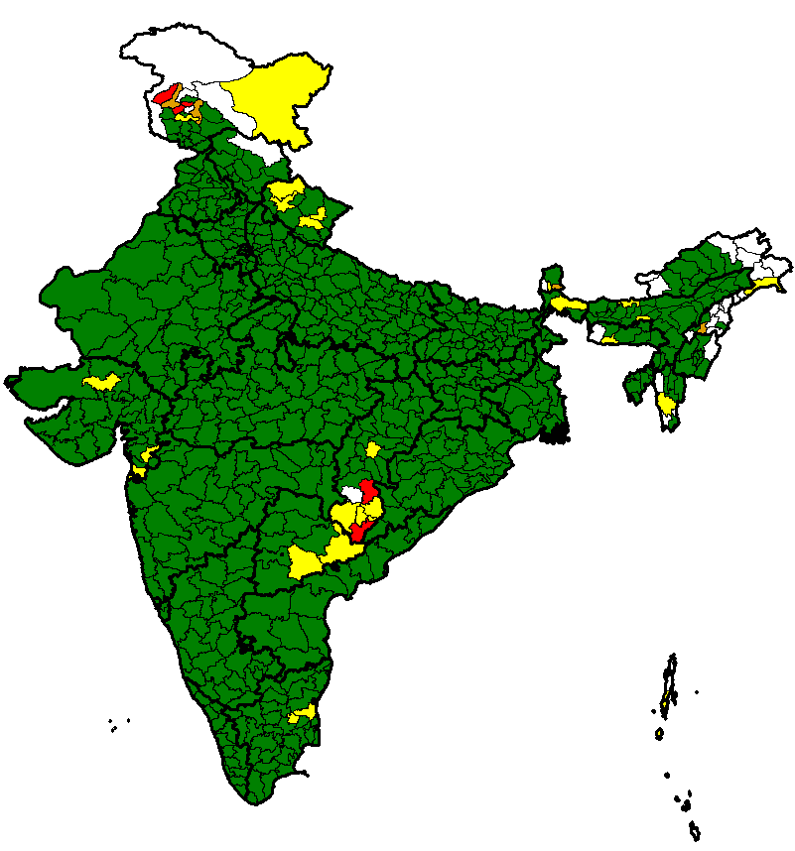
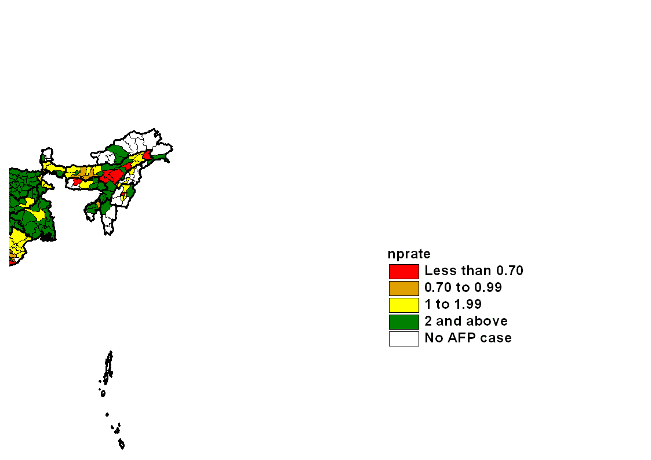
Polio-free status - sensitive surveillance
Number of AFP case reporting sites
Non-polio AFP rate, 2014
12.08
* data as on 14 March 2015

Slide 28
Polio laboratories maintain high efficiency
Number of stool specimens processed
Number of days from stool received in laboratory to final result
2006
2007
2008
2009
2010
2011
2012
2013
2014
Notes:
28

Slide 29
Proposed expansion of environmental surveillance
Additional sites
in Mumbai
Existing environmental
surveillance sites
Hyderabad
Expansion of environmental surveillance in 2015

Slide 30
Preparedness for emergencies

Slide 31
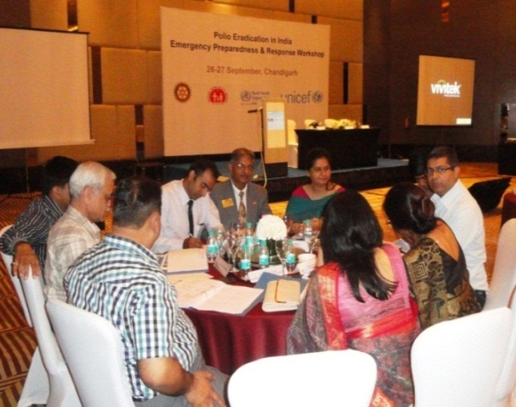
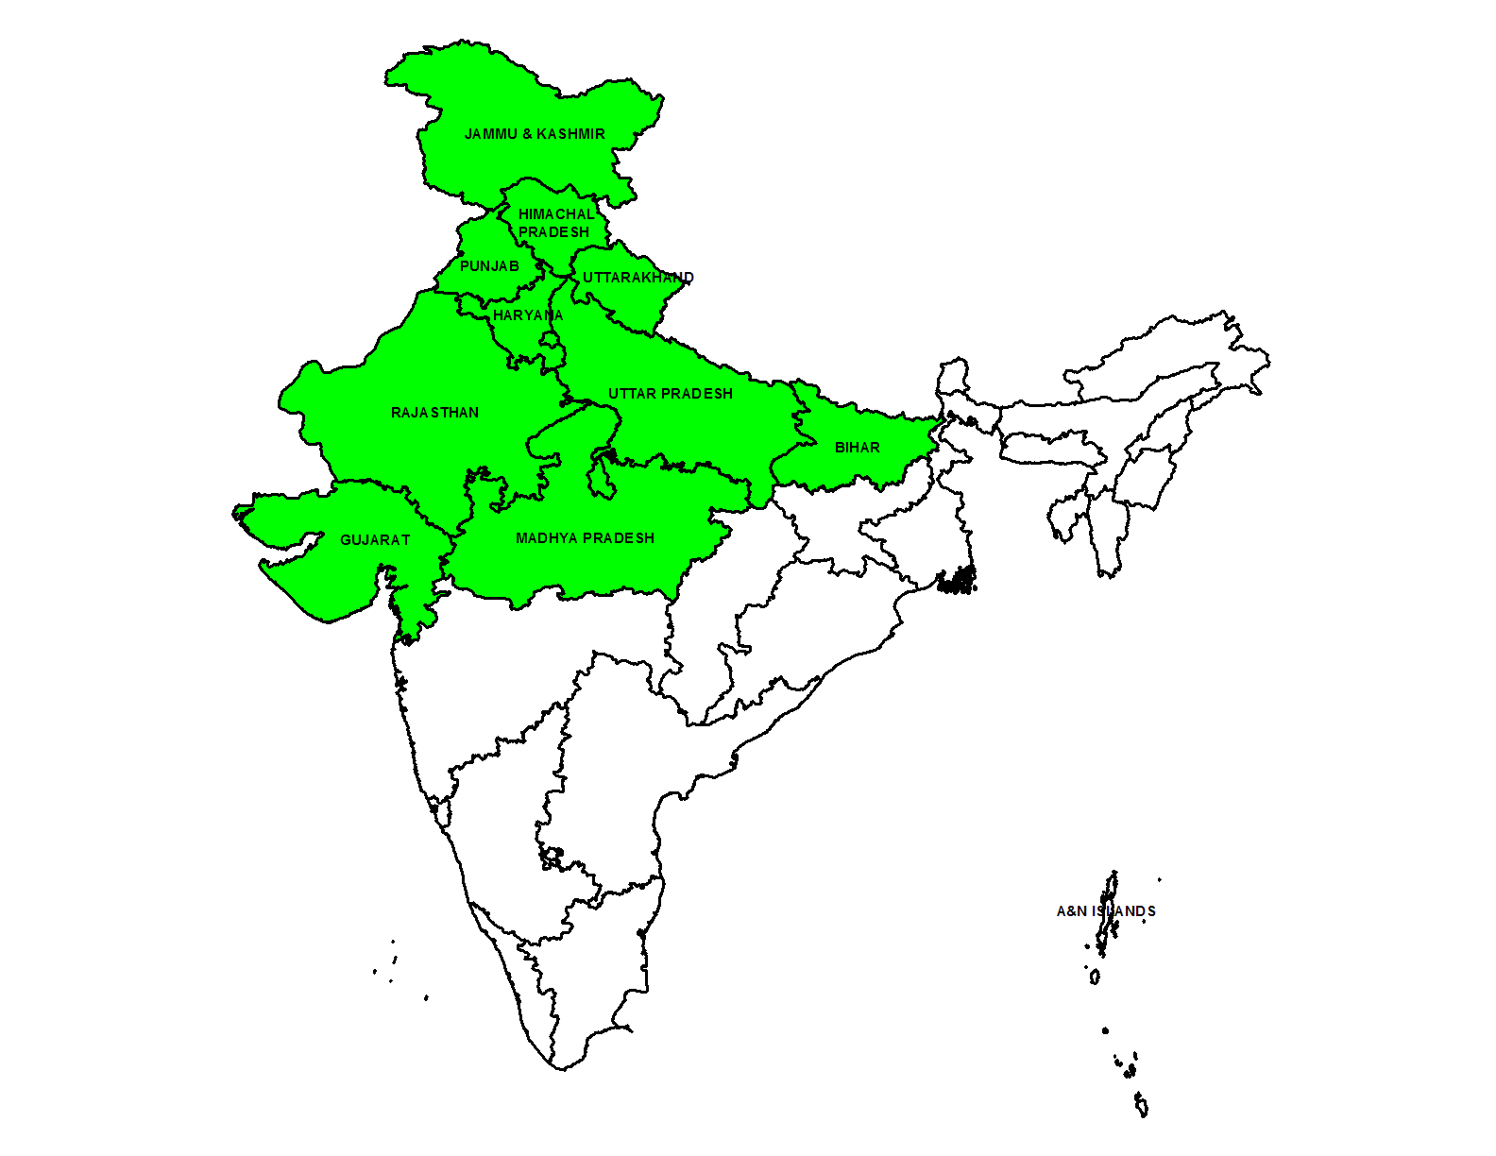
Emergency preparedness to respond to an importation
Any WPV/cVDPV in India to be treated as a public health emergency
All states/UTs in a state of readiness for mop up vaccination within 7 days of detection of any WPV
Table-top simulation exercises completed in 12 states at high risk for importation since last IEAG, plans revised
Simulation exercises in remaining states planned in 2015/2016
CHANDIGARH
DELHI

Slide 32
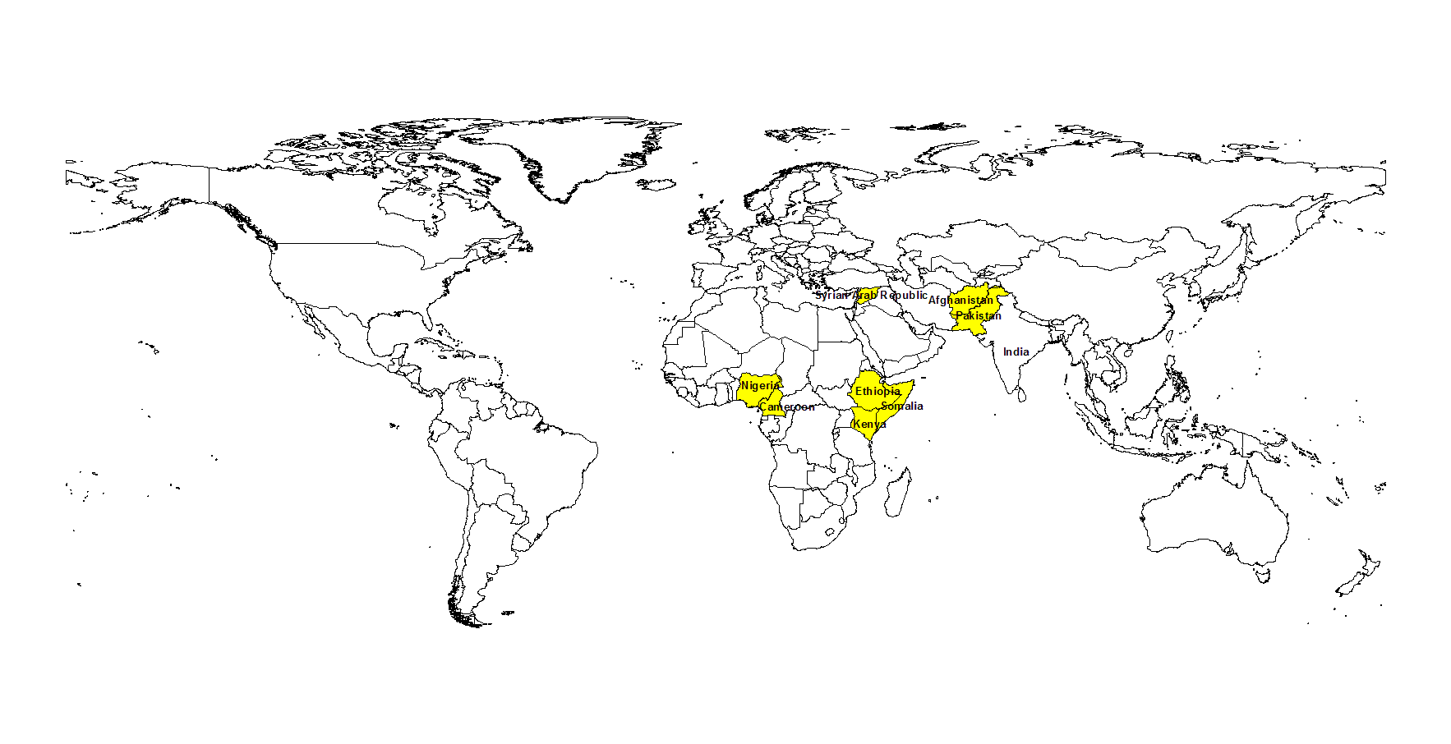
Mitigating the risk of importation
OPV vaccination to all travelers to and from 8 countries 4 weeks prior to travel irrespective of age and previous vaccination status
Countries:
Afghanistan
Pakistan
Nigeria
Cameroon
Ethiopia
Somalia
Kenya
Syria
Countries with advisory for polio vaccination prior to international travel

Slide 33
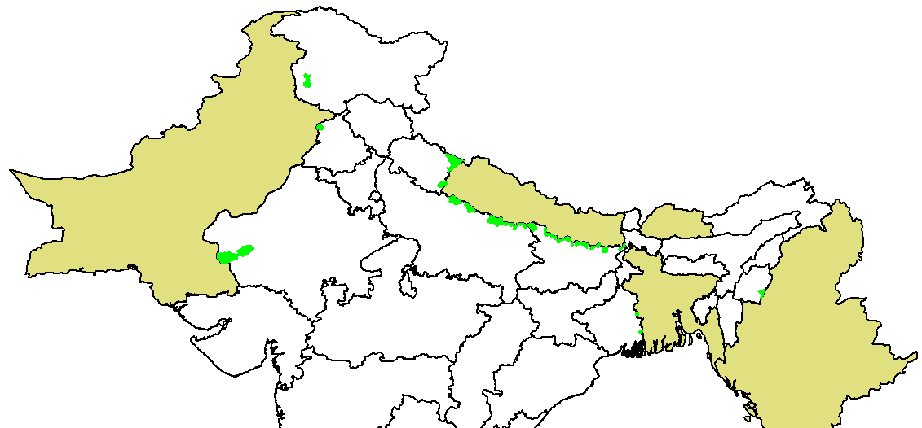
Mitigating the risk of importation
Continuous vaccination of children at border crossing points
Indo-Pak border
5 vaccination posts
> 71,000 children vaccinated from
Sep 2011 to Feb 2015
Indo-Nepal border
90 vaccination posts
> 6.8 mn children vaccinated from
Aug 2010 to Feb 2015
PAKISTAN
NEPAL
INDIA
BANGLADESH
MYANMAR
Indo-Bangladesh border – 3 posts
> 43,000 children vaccinated from Mar 2013 to Feb 2015
Indo-Maynmar border – 3 posts
> 21,000 children vaccinated from Apr 2013 to Feb 2015
Indo-Bhutan border – 1 posts
> 39,000 children vaccinated from Jul 2013 to Feb 2015
Vaccination post
Blocks with vaccination post

Slide 34
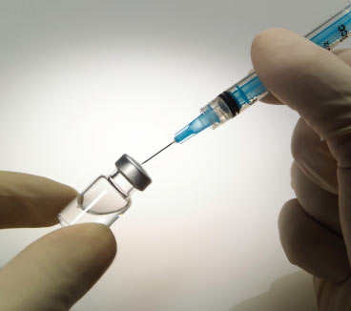
Polio Endgame Strategy
Risk-free withdrawal of OPV to minimize the risks associated with use of OPV in the post eradication phase
  2015: Build type 2 immunity prior to switch: Introduce IPV
  2016: tOPV to bOPV switch in RI & SIAs
  ~2019: Withdrawal of OPV from programme

Slide 35
Summary
India polio-free for more than 4 years
Risk of importation persists
Appropriate actions being taken to mitigate the risks
Preparedness for polio endgame on track

Slide 36
Questions to IEAG
Does the IEAG endorse the proposed scope, frequency and vaccine type for SIAs during 2015-2017?
Should India continue vaccination of travelers to and from polio infected countries? If yes, for how long?
Should India continue the cross border vaccination with all neighboring countries? If yes, for how long?
When is the switch from tOPV to bOPV expected? Procurement will depend on early decision.

Slide 37
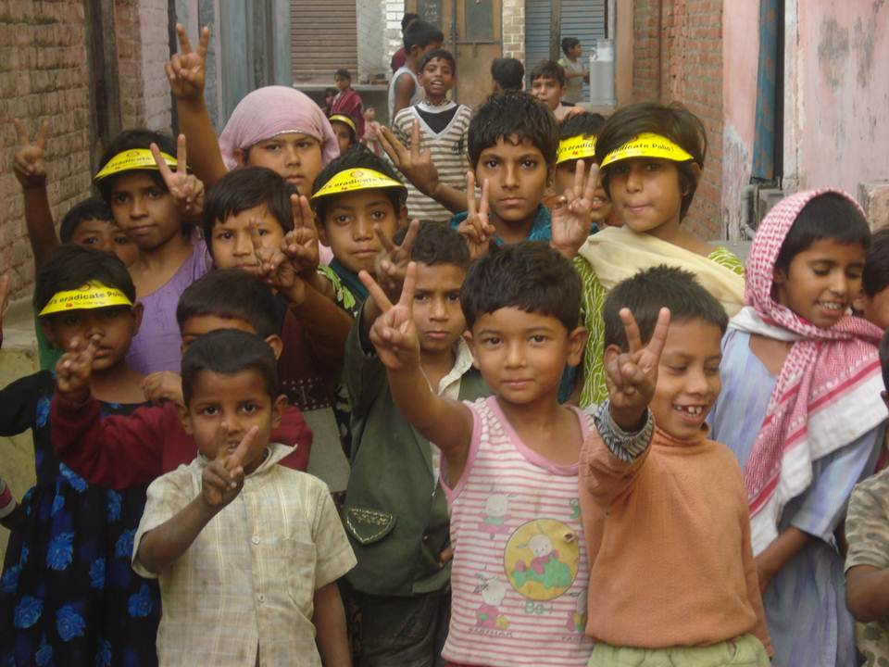
Thanks

Slide 38
Question to IEAG:
Does the IEAG endorse the proposed scope, frequency and vaccine type for SIAs during 2015-2017?
Proposed SIA schedule, 2015-17
2015
2016
2017
NID, ~170 mn children
with bOPV
NID, ~170 mn children
with tOPV
SNID, ~75 mn children
with bOPV

