Slide 1
Update on activities under laboratory containment of wild Polio viruses in India
Dr. Rashmi Arora
Scientist G & Head
Division of Epidemiology & Communicable Diseases
Indian Council of Medical of Medical Research

Slide 2
National Task Force
Constituted by the Ministry of Health & Family Welfare, Govt of India on 11 September 2003.
Secretariat: Indian Council of Medical Research.
Laboratory containment: necessary to avoid chance reintroduction of WPV into the community when indigenous circulation of WPV will be interrupted.

Slide 3
Members of Task Force
Member Secretary: Sr. DDG, ICMR
Chairman: DG, ICMR
Technical Coordinator: Director, EVRC
Other members
Secretary/ Representative MOH&FW
Secretary/ Representative Min. of S&T
Secretary/ Representative Min. of Environment
Secretary/ Representative Min. of Defense
Secretary/ Representative Min. of Agriculture /Veterinary
Vaccine Manufacturers
Indian Asso. of Universities
Asso. of Medical Microbiologists
NPSP
Composition: 21 members, Option to co-opt experts as and when required

Slide 4
Members of Task Force
Independent Experts:
Prof. T. Jacob John, Emeritus Scientist
Prof. U. C. Chaturvedi, Emeritus Scientist
Prof. Shobha Broor, All India Instt of Med Sciences
Dr. Amit Ghosh, Director, Instt of Med Technology
Director, National Environmental Engineering Research Institute, Nagpur
Director, Indian Institute of Sciences, Bangalore
Director, National Institute of Cholera & Enteric Diseases, Kolkata
Director, National Institute of Virology, Pune
External experts to be co-opted as and when required

Slide 5
Terms of Reference
Write the National Plan.
Conduct national search for labs: list bio-medical labs storing WPV infectious/ potentially infectious materials.
Contact: enlisted agencies & labs, request them to search their labs for WPV infectious/ potentially infectious materials, complete documentation & report back to the National Task Force.
Monitor & follow-up with Agencies/labs to ensure that activities are done in timely & effective manner.

Slide 6
Terms of Reference
Visit concerned Agencies, Institutions, or Labs of concern.
Review all completed forms submitted by different Agencies and labs.
Prepare final National Inventory for Containment, submit to National Certification Committee with supporting documentation.
This will be included as part of the national documentation for certification that will be submitted to the Regional Certification Commission and copy to the WHO South East Asia Regional Office

Slide 7
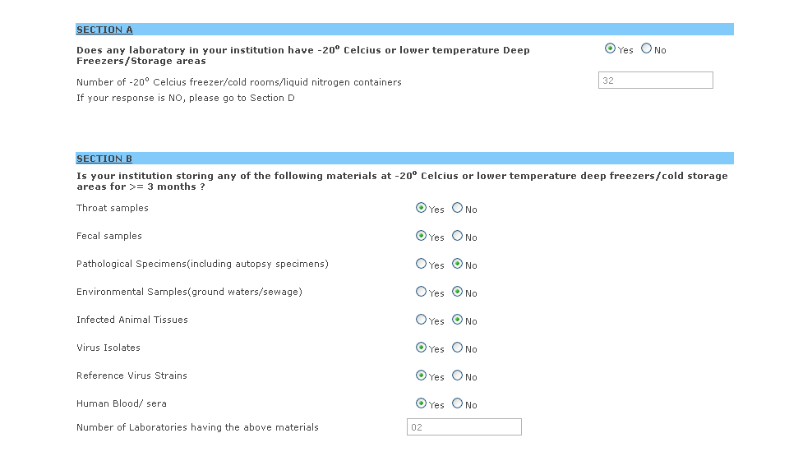
Laboratory Survey Form Sections A & B

Slide 8
Global Action Plan for Laboratory Containment of Wild polioviruses (2nd edition, June 2003)
Phase-I
Begins when polio cases are decreasing in the Region
Laboratory Survey and inventory
Phase-II
Begins after 1 year has lapsed without isolation of virus anywhere in world
Implementation of containment begins
2 yrs pass with no case reported globally
Containment completed and documentation submitted
3 or more years pass with no case reported globally
Global polio eradication certified
Phase-III
Post-eradication data and experience in countries suggest the need to consider discontinuation of polio immunization

Slide 9
History of EVRC.
Mandate : Epidemiological studies, vaccine trial and assisted Haffkine Institute in production of OPV
Polio research Unit established in 1949
Enterovirus Research Unit 1950
Renamed ERC April 1981
Identified as WHO Polio Network Lab 1992
WHO Regional Reference lab 1997
WHO Global specialised Lab 2000

Slide 10
Activities undertaken under the NTF
Laboratory survey implementation document was approved by NTF in August 2012
Financial support for Laboratory survey was received in April 2013 from Min. Of Health & Family Welfare.
ICMR Bioinformatics Centre provided support for online database management.

Slide 11
Political and administrative commitment
Hon. Health Minister sent DO letters to Chief Ministers and Governors of all States and U/Ts requesting support and oversight
Cabinet Secretary wrote to Chief Secretaries of all States and U/Ts requesting support and oversight
Health Secretary wrote to all Principal Secretaries requesting support and oversight.
Chairman of NTF requested cooperation of all the biomedical laboratories contacted by the NTF

Slide 12
Bio-medical Laboratory Survey Implementation Plan
Bio-medical laboratory survey implementation plan was developed from the National Action Plan.
No special legislation was enacted for the laboratory survey.
Laboratory survey was conducted by three bodies: National Task Force, NPSP and State Health Departments.

Slide 13
Three pronged approach
NTF/ERC enlisted biomedical laboratories by searching internet, scientific journals, lay press publications, advertisements, conference delegates lists and databases (various sources). NPSP surveyed all AFP case reporting sites.
State Governments surveyed laboratories that were not covered by NPSP.
Laboratory survey was conducted from NTF Office at Enterovirus Research Centre Mumbai. Laboratory survey database was hosted at the Bio-Informatics Centre, ICMR.

Slide 14
Agencies/Laboratories Surveyed
•Indian Council of Medical Research
•Department of Biotechnology
•Council for Scientific and Industrial Research
•Defence
•Veterinary Sciences
•Railways hospitals/ ESIS hospitals
•Vaccine manufacturers
•Autonomous Research institutions

Slide 15
Result of Phase I Survey of Bio-medical Laboratories for wild poliovirus risk
Nos. Laboratories surveyed 7 1469
. Laboratories with Freezers & bio-materials 1072
? Nos. Laboratories with Freezers and risk materials 251 Nos. Laboratories discarded after review 111
Nos. Laboratories for on-site validation 140
Final National inventory of labs storing Potentially WPV infectious materials only 50
Laboratories with potential risk material only 49
Laboratories with wild poliovirus risk 1
Notes:
ICMR, CSIR , DBT, Autonomous , Central Govt ,state Govt , Pvt and others

Slide 16
Laboratory data validation
Biomedical laboratory survey was started in April 2013 and completed in January 2014
NTF met on 20th November 2013 to review the progress of Phase I containment activities and recommended for validation of Labs before finalization of the list of “Inventory of Laboratories storing WPV/Potentially infectious materials.

Slide 17
Laboratory data validation
A plan for on-site validation of data submitted by risk laboratories.
It is planned that NTF will hold a meeting of all “risk” laboratories at ICMR, HQ to further reduce the risk, dispose of WPV and potentially infected materials.

Slide 18
Phase I containment activities have been completed in India
The Final National Inventory 50 laboratories storing wild poliovirus or potentially wild poliovirus infected material included in the report.
Phase I activities report was submitted to the NCCPE on 5th March for inclusion in the National Document on Polio Eradication

Slide 19
South East Asia Region of the World Health Organization was certified “Polio-free” by the SEA-RCCPE at 14:37 on the 27th March 2014

Slide 20
Management of the Inventory
National Task Force will be responsible for maintaining the Inventory and annual updates.
Computerized database is currently maintained at the BIC, ICMR with a backup at ERC Mumbai.
Hard copy data are stored by National Task Force at the Enterovirus Research Centre Mumbai.
Computerized database is updatable and searchable
Laboratory survey data shall be the property of the NTF.

Slide 21
Road map for the action plan for phase II activities
Identify labs storing risk materials.
Ensure safe handling of risk materials by labs.
Assist to identify unneeded materials.
Emphasize complete documentation of disposal of WPV infectious/potentially infectious materials.
Provide guidance for safe disposal of the stocks of WPV and potentially infectious material.
Risk reduction activities (IEC)
Prepare annual update

Slide 22
Action Plan
Workshop(s) for safe disposal of WPV and WPV potentially infectious materials
–Invite all 50 laboratories to participate
–Understand laboratory needs for continued storage
of poliovirus risk materials
–Identify unneeded material for disposal
–Prepare a timeline for risk reduction activities in each of the 50 laboratories
Efforts to identify any new laboratories for National Survey
–Zone-wise distribution
West (12), East (10), North (13), South (15)

Slide 23
Action Plan Contd.
Site visits to assist safe disposal.
Site visits to confirm implementation of the plan of action (validation).
Identify (list) laboratories storing Sabin OPV strains/isolates/clinical samples.
NTF meeting – to Update preparation and submission.

Slide 24
Thank You

Slide 25
Activities on Non-Polio AFP
High number of AFP cases even after eradication of Polio – a major concern (2013: 54,632).
ICMR is planning to take up a study on aetiology and transmission dynamics of non-polio enteroviruses causing AFP.
All 8 National Polio Labs and ICMR VRDLs to be involved.
Protocol development underway

